Slide 1
Probing the valence quark region of nucleons with Z bosons at LHCb
报告人: 李天齐，导师: 李衡讷
第二届“粤港澳”核物理论坛
2023年6月17日-20日
广东广州

Slide 2
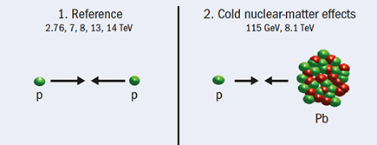
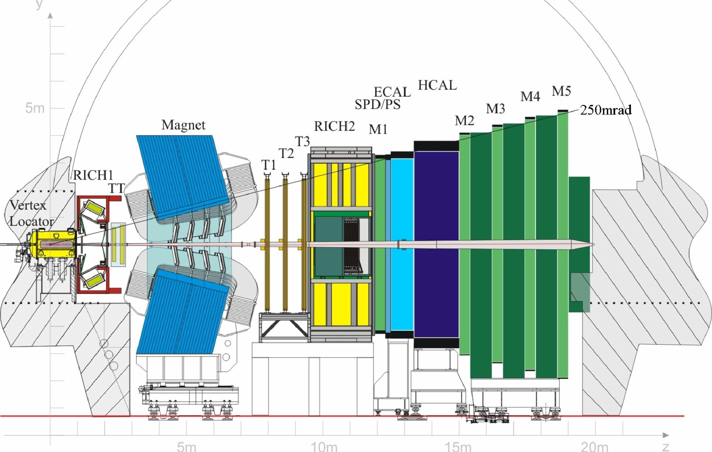
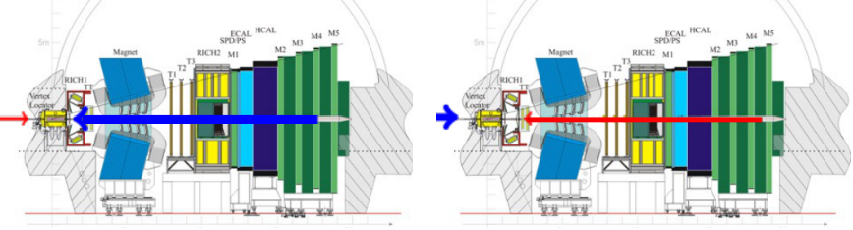


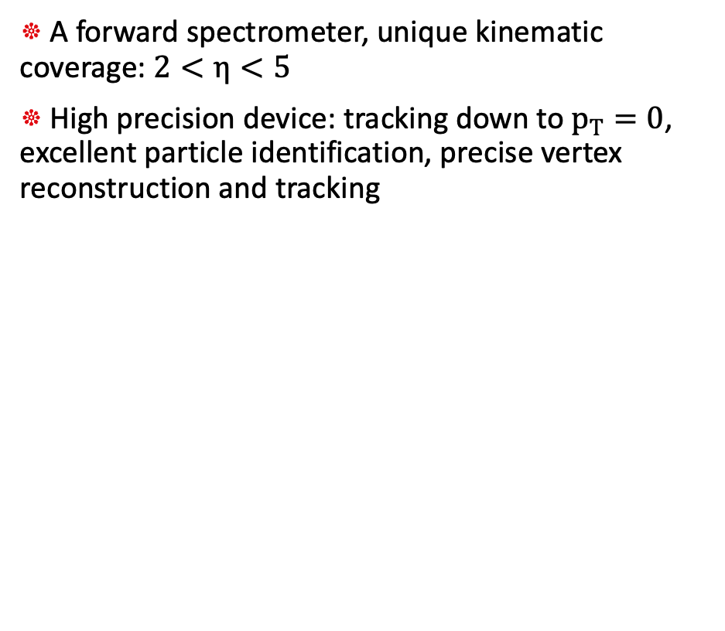

The LHCb detector
A forward spectrometer, unique kinematic coverage: $2<η<5$
High precision device: tracking down to $p_{T}=0$, excellent particle identification, precise vertex reconstruction and tracking
Collider mode for probing bosons: pp, pPb
Beam configurations for p-Pb collisions
Forward (pPb)
Backward (Pbp)
p
Pb
$$1.5<y^{∗}<4.0$$
$$−5.0<y^{∗}<−2.5$$
y*: rapidity in center of mass frame, required a rapidity shift of about 0.47 w.r.t. the lab frame coverage

Slide 3
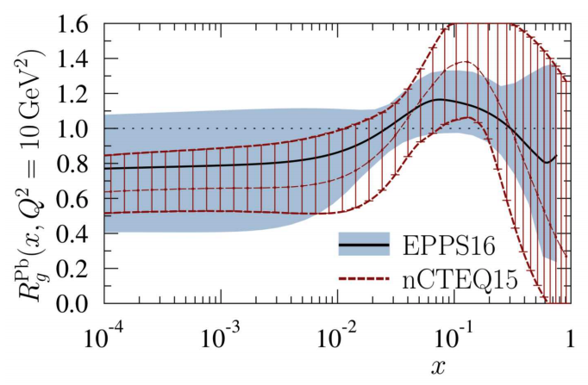
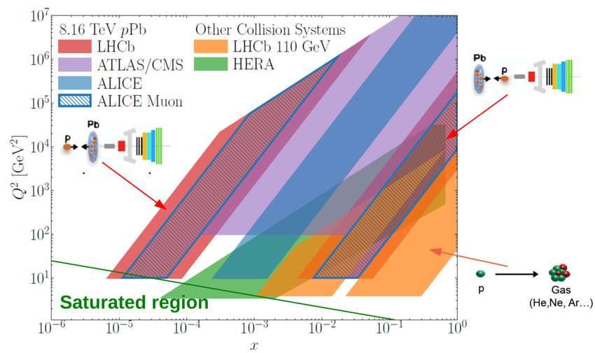
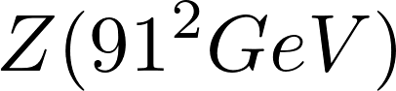
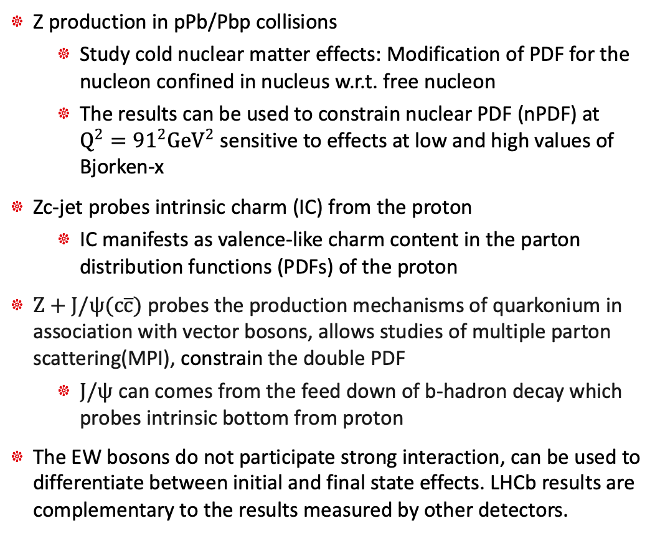
The probe of nucleon structure
Ref. [PoS (QCDEV2017) 058]
Z production in pPb/Pbp collisions
Study cold nuclear matter effects: Modification of PDF for the nucleon confined in nucleus w.r.t. free nucleon
The results can be used to constrain nuclear PDF (nPDF) at $Q^{2}={91}^{2}GeV^{2}$ sensitive to effects at low and high values of Bjorken-x
Zc-jet probes intrinsic charm (IC) from the proton
IC manifests as valence-like charm content in the parton distribution functions (PDFs) of the proton
$Z+J/ψ(c\overline{c})$ probes the production mechanisms of quarkonium in association with vector bosons, allows studies of multiple parton scattering(MPI), constrain the double PDF
$J/ψ$ can comes from the feed down of b-hadron decay which probes intrinsic bottom from proton
The EW bosons do not participate strong interaction, can be used to differentiate between initial and final state effects. LHCb results are complementary to the results measured by other detectors.

Slide 4
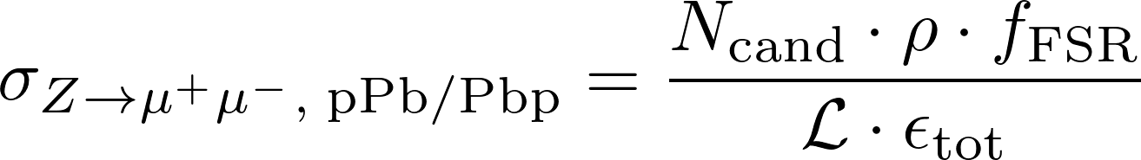
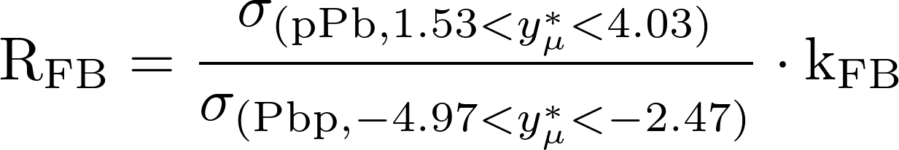
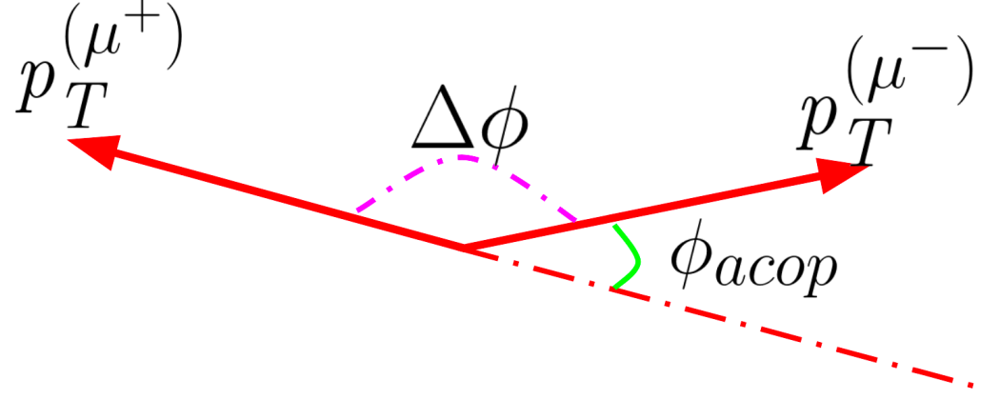
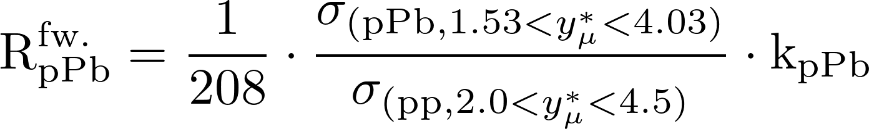
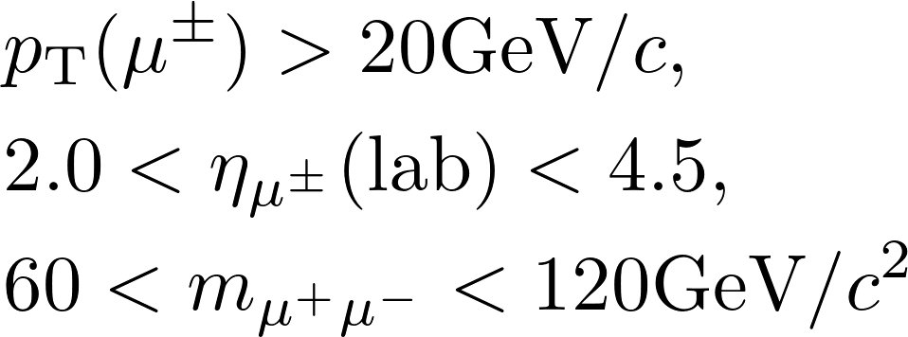
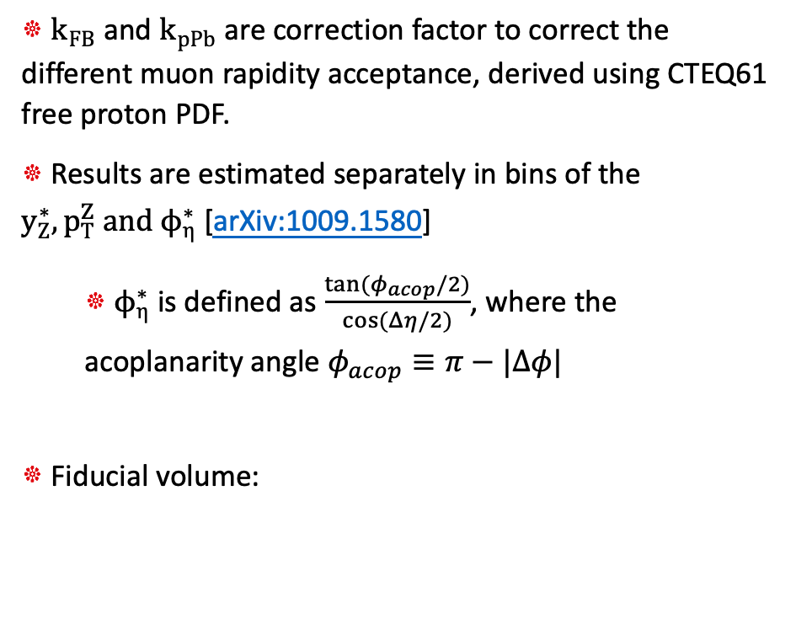
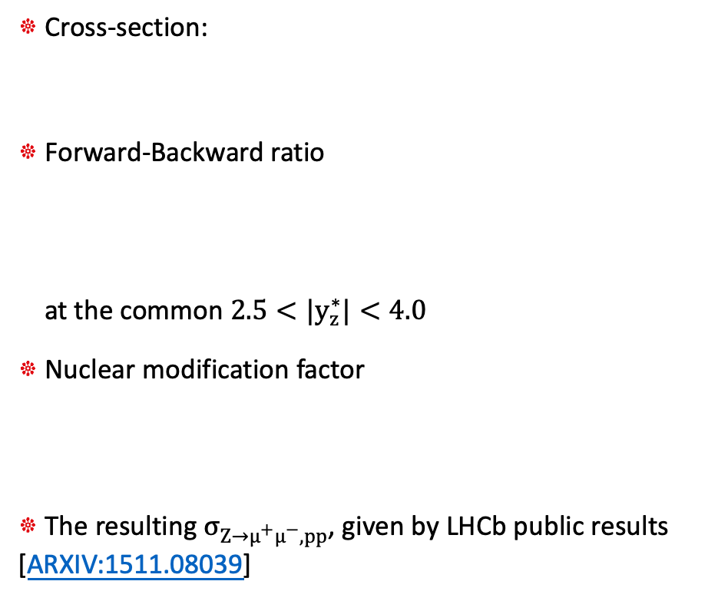
Z prodution in pPb collisions at 8TeV
JHEP 06 (2023) 022
Cross-section:
Forward-Backward ratio
at the common $2.5<|y_{z}^{∗}|<4.0$
Nuclear modification factor
The resulting $σ_{Z→μ^{+}μ^{−}, pp}$, given by LHCb public results [ARXIV:1511.08039]
$k_{FB}$ and $k_{pPb}$ are correction factor to correct the different muon rapidity acceptance, derived using CTEQ61 free proton PDF.
Results are estimated separately in bins of the $y_{Z}^{∗}, p_{T}^{Z} and ϕ_{η}^{∗}$ [arXiv:1009.1580]
$ϕ_{η}^{∗}$ is defined as $\frac{tan⁡(φ_{acop}/2)}{cos⁡(Δη/2)}$, where the acoplanarity angle $φ_{acop}≡π−|Δφ|$
Fiducial volume:

Slide 5
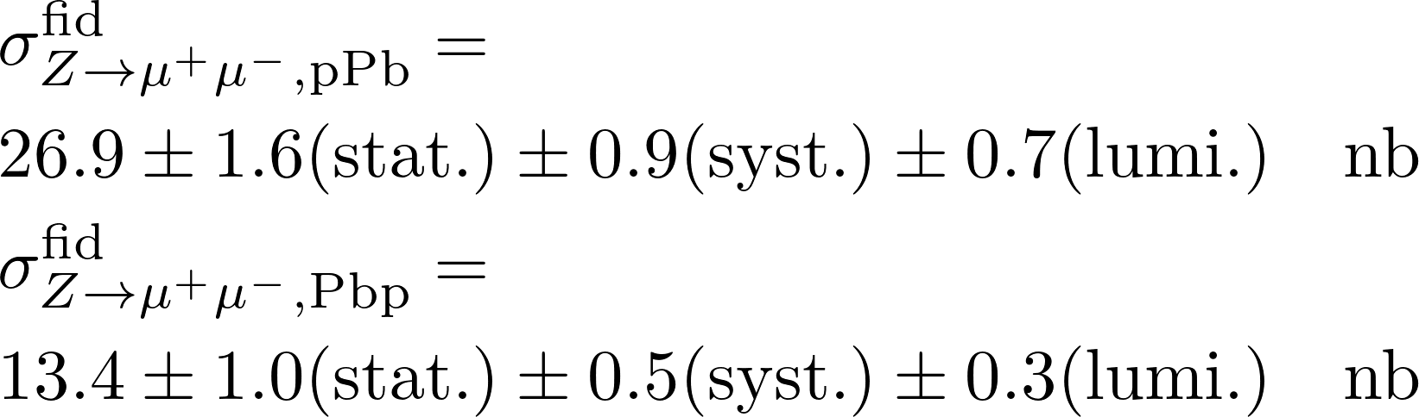
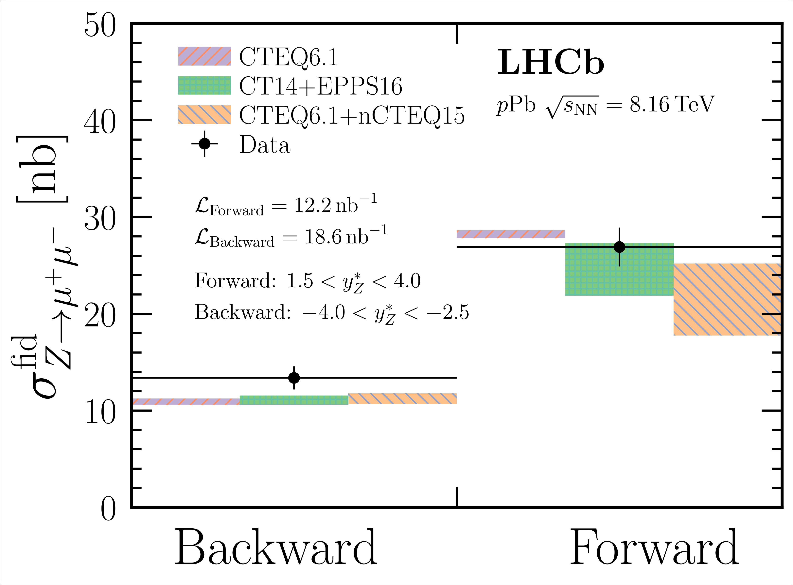
Fiducial cross-section results
JHEP 06 (2023) 022
Total fiducial cross-section
Measured results compatible with the theoretical calculations within current uncertainties:
CTEQ61(PDF) for both p and Pb
CT14(PDF) for p and EPPS16(nPDF) for Pb
CTEQ61 for p and nCTEQ15( nPDF) for Pb
Forward result(at small Bjorken-x) shows strong constraining power on the nPDF.
Events for backward: 167
Events for forward: 268

Slide 6
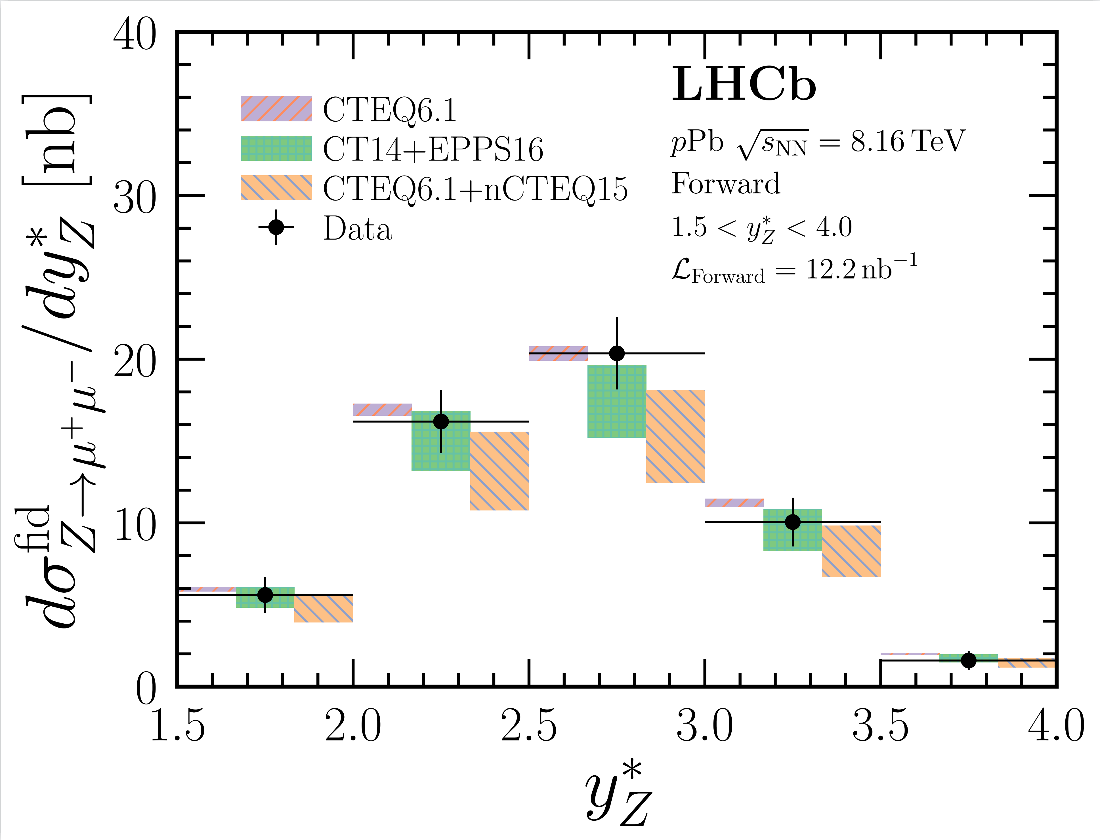
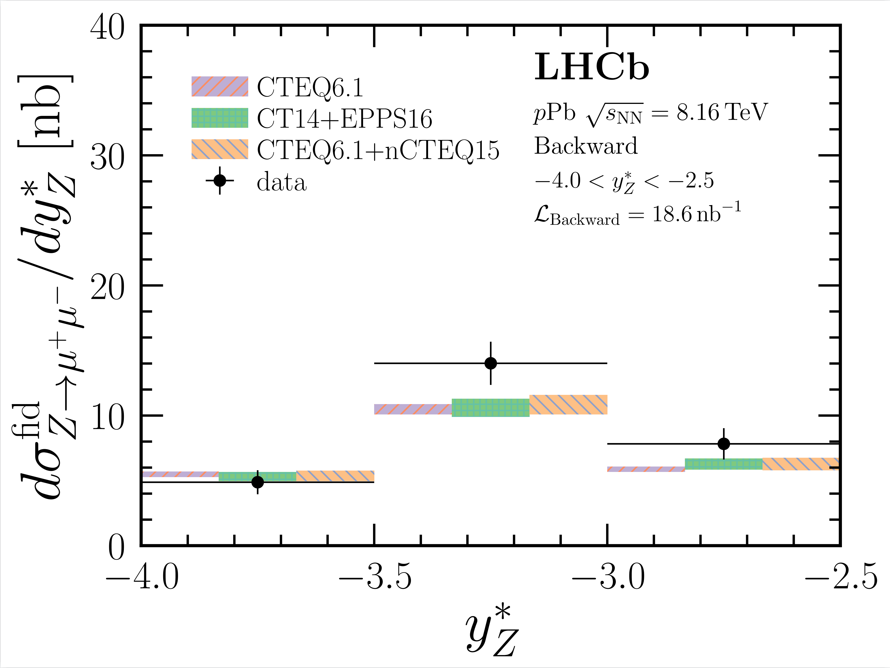
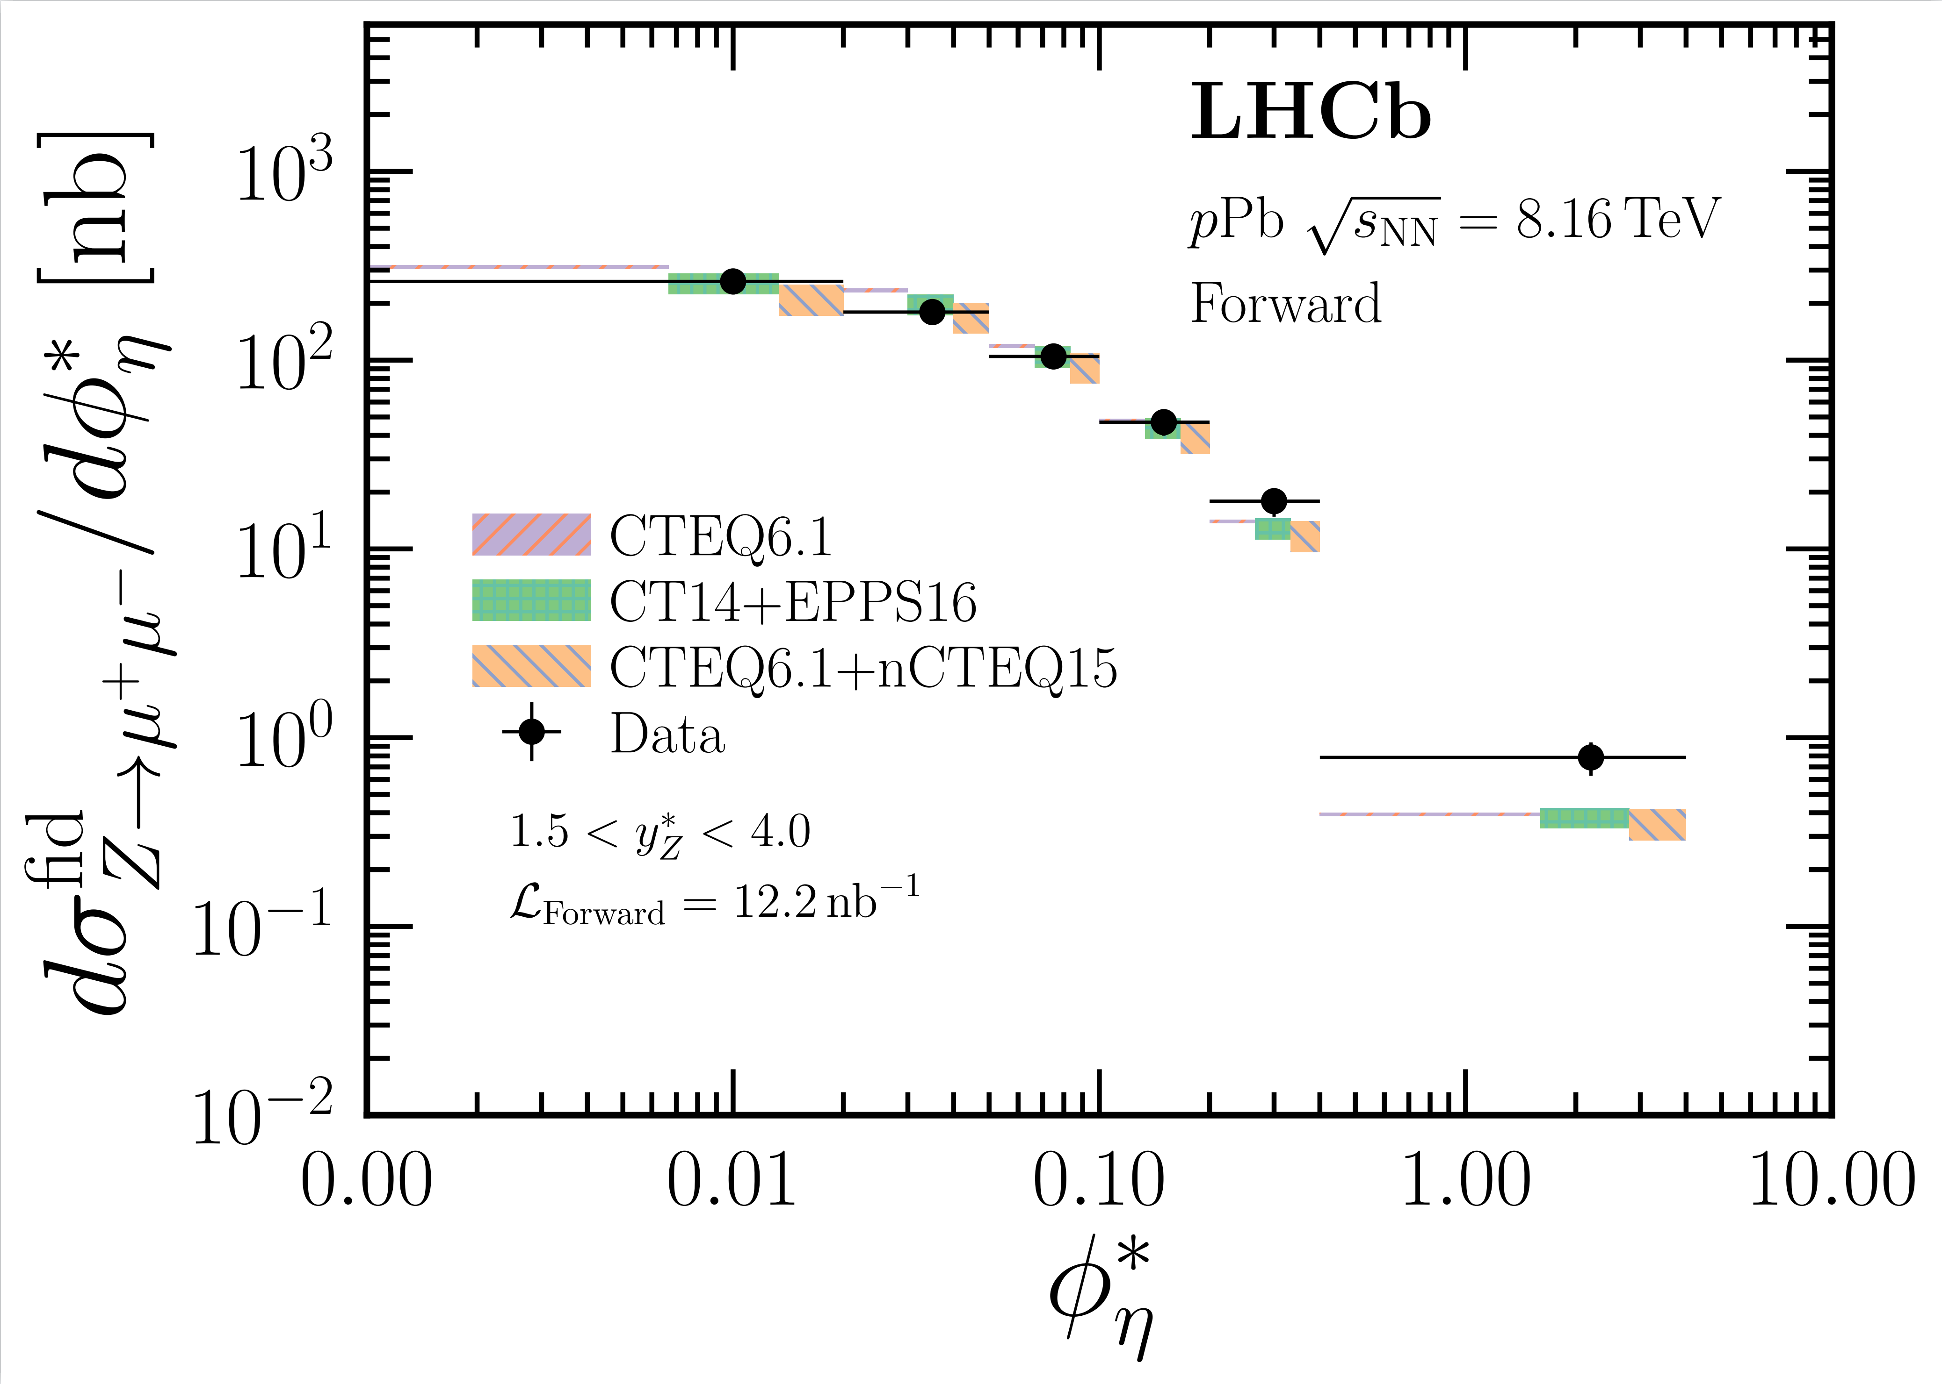
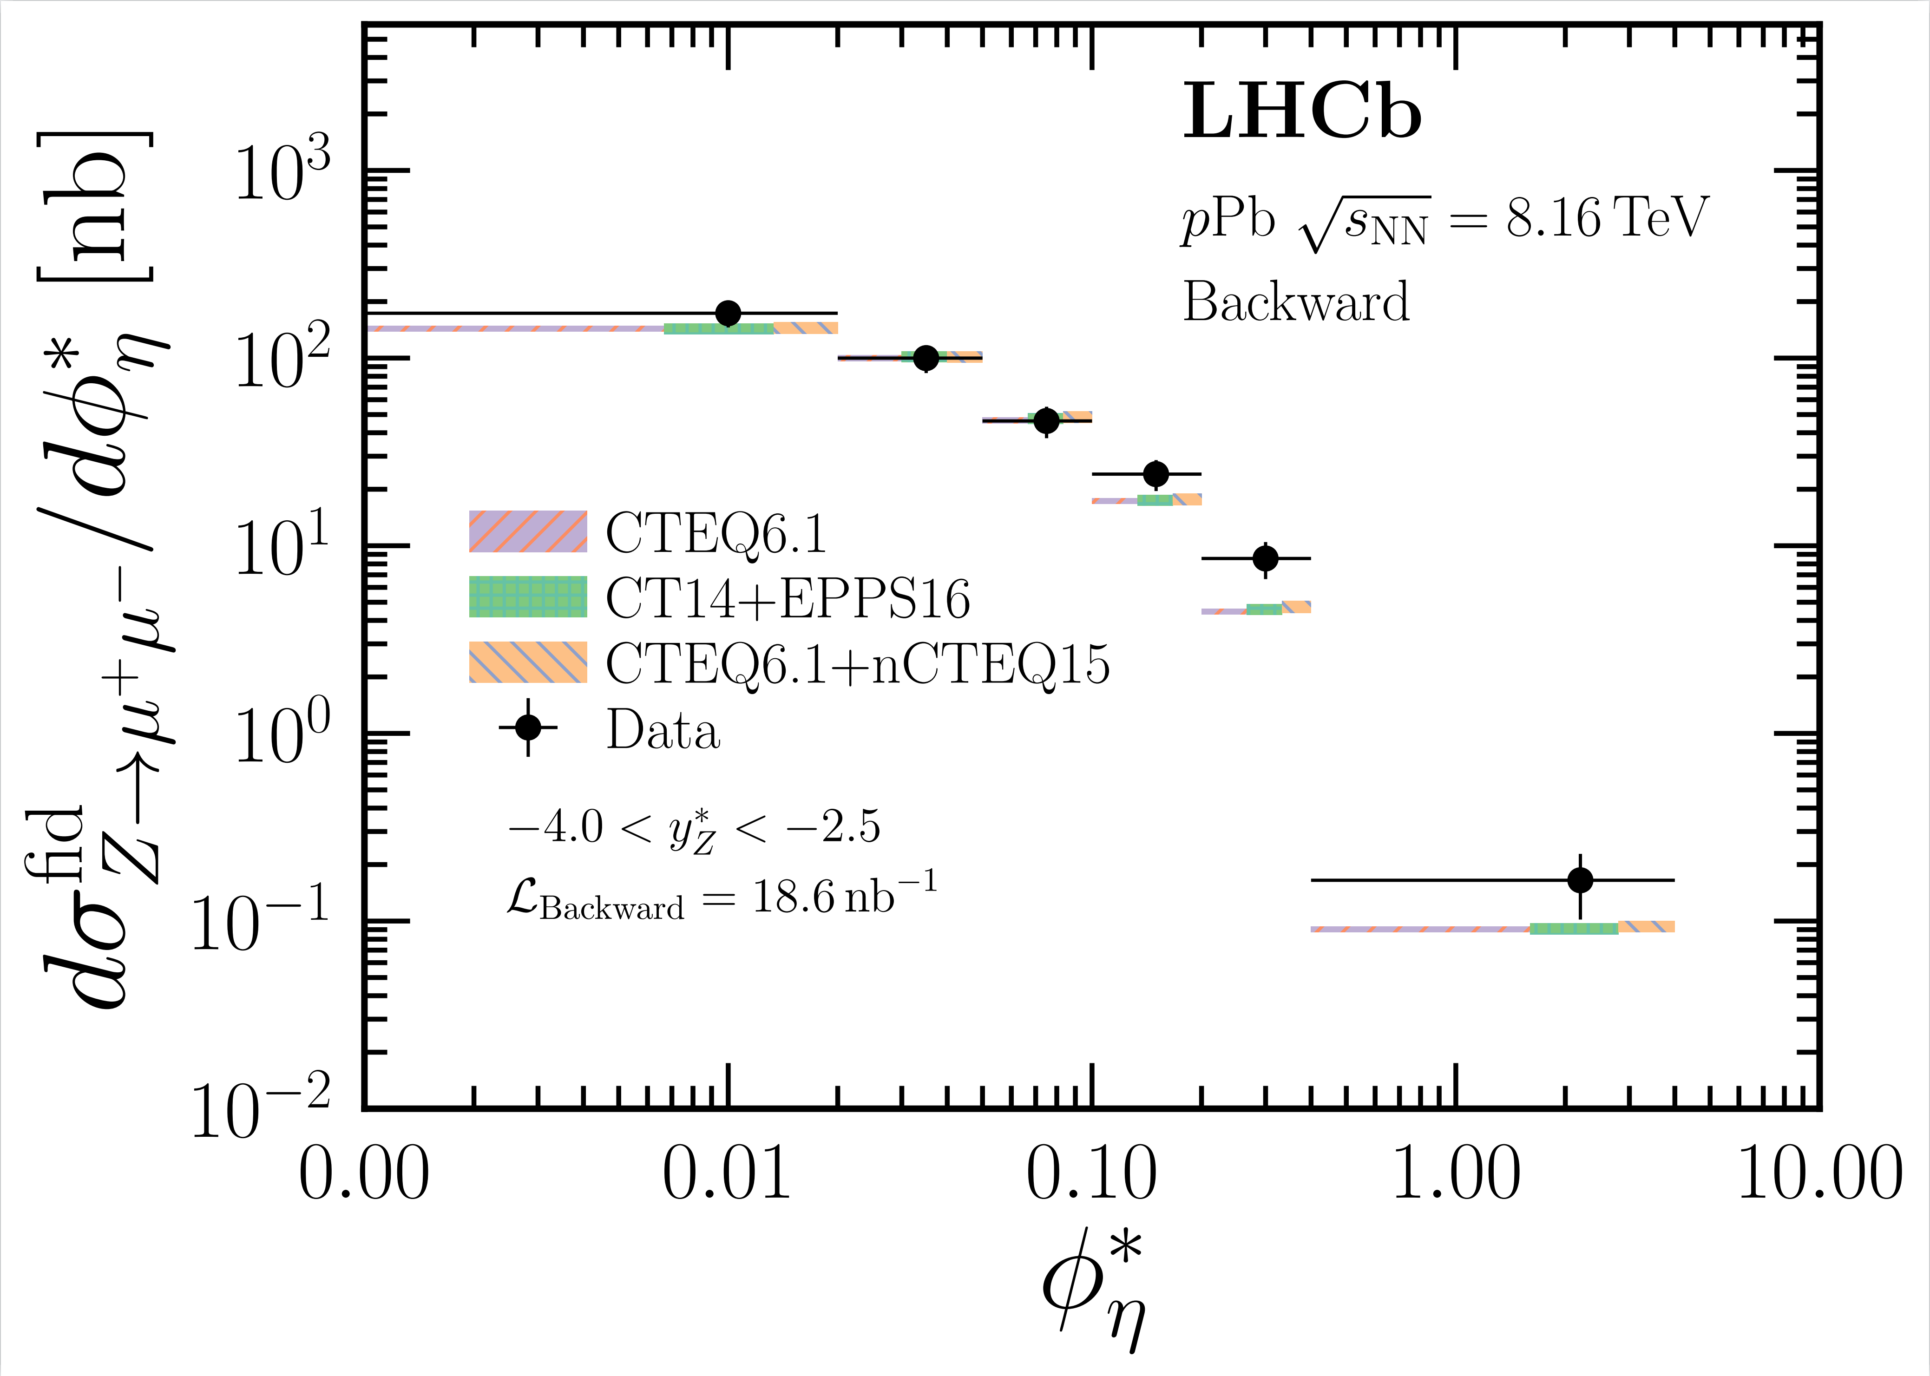
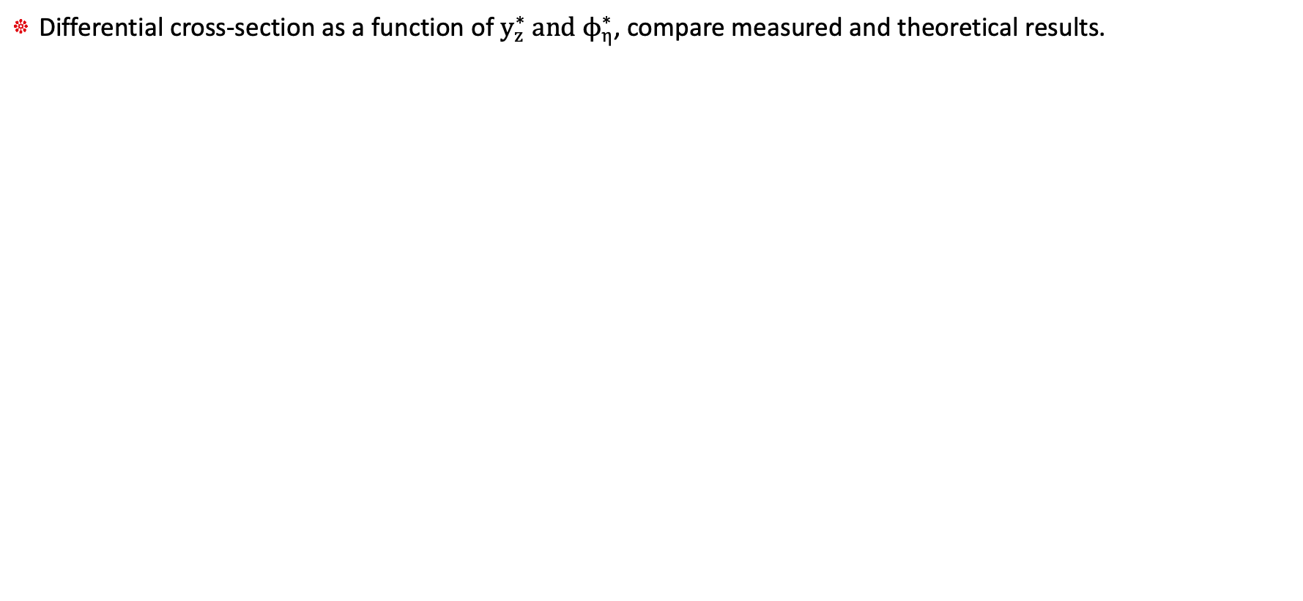
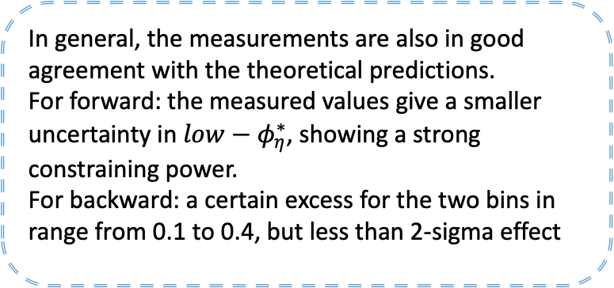

Cross-section result: $y_{z}^{∗}, ϕ_{η}^{∗}$
JHEP 06 (2023) 022
Differential cross-section as a function of $y_{z}^{∗} and ϕ_{η}^{∗}$, compare measured and theoretical results.
For forward: the measurements show a good agreement with predictions, a smaller uncertainty to constrain the nPDFs.
For backward: the measured results' uncertainties are greater than theoretical calculations
In general, the measurements are also in good agreement with the theoretical predictions.
For forward: the measured values give a smaller uncertainty in $low−φ_{η}^{∗}$, showing a strong constraining power.
For backward: a certain excess for the two bins in range from 0.1 to 0.4, but less than 2-sigma effect

Slide 7
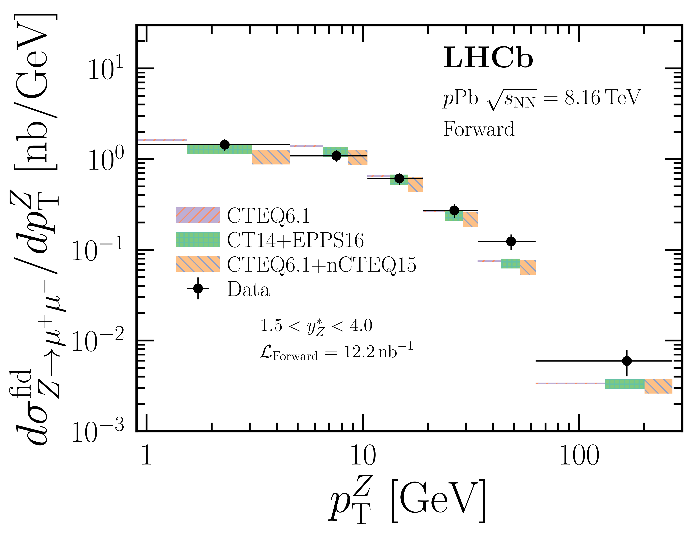
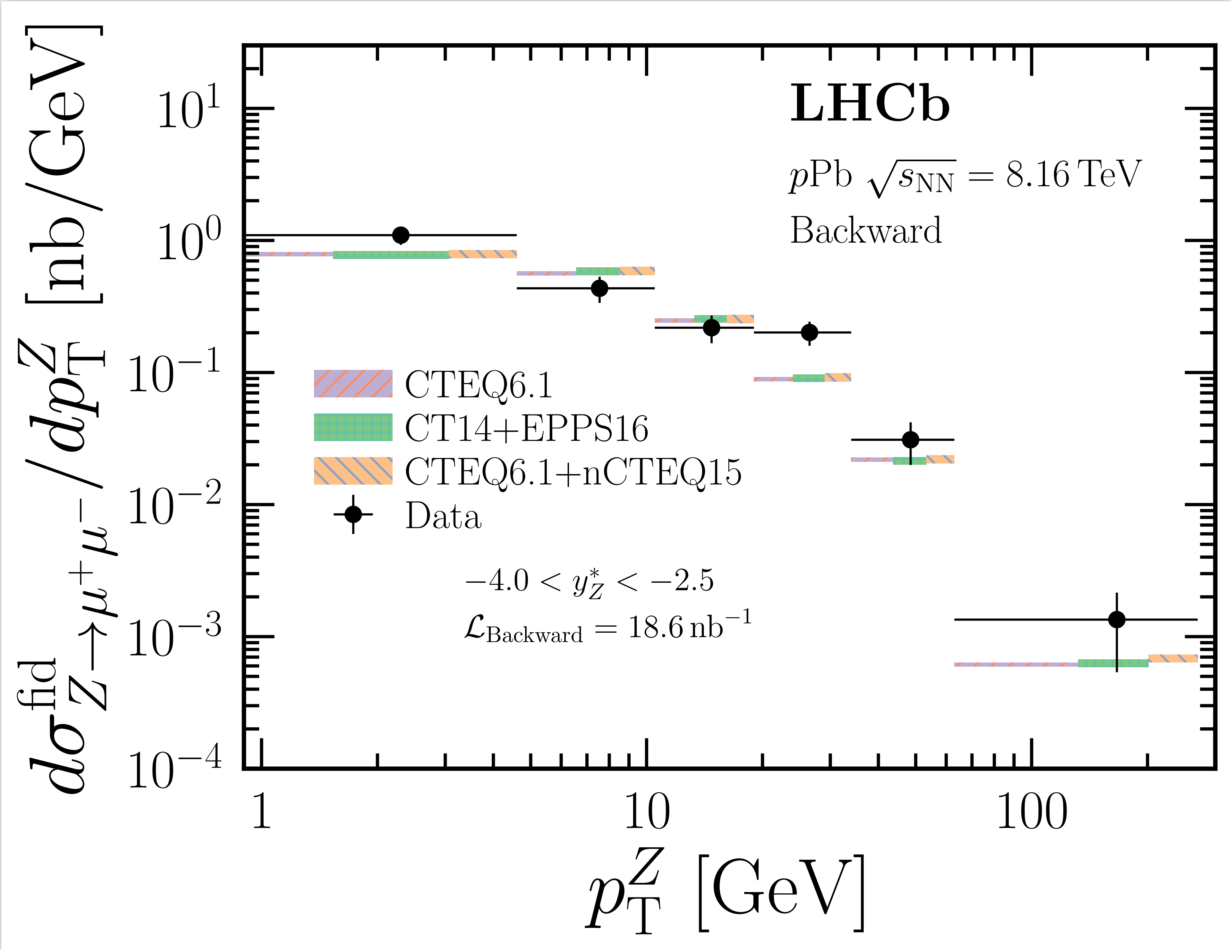
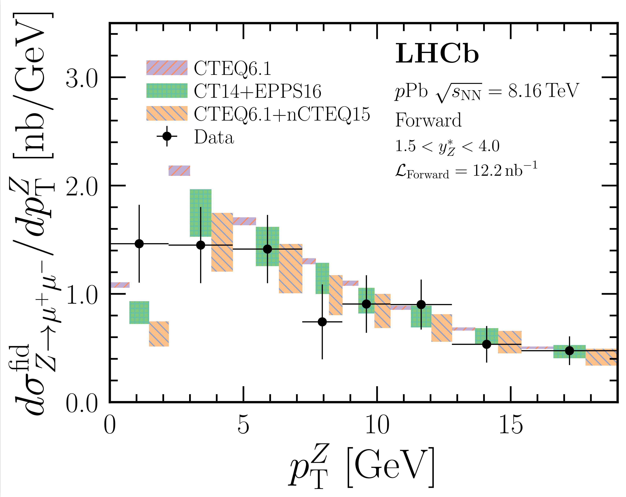
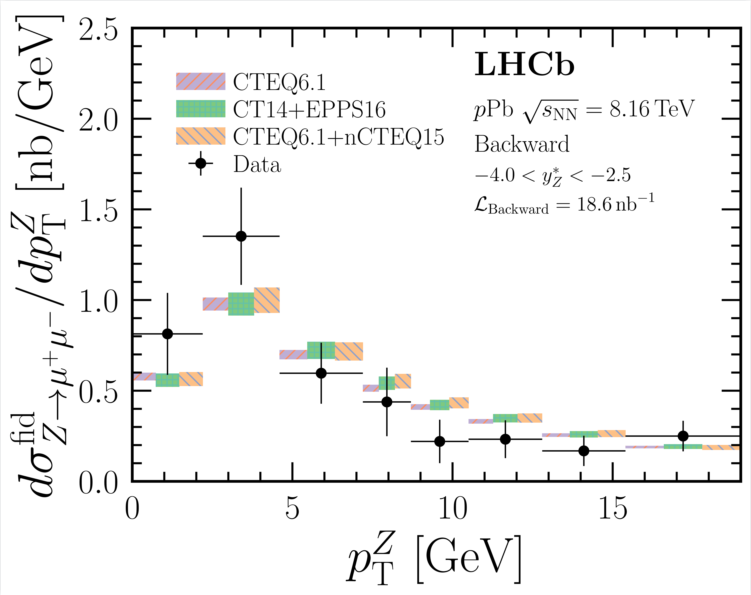

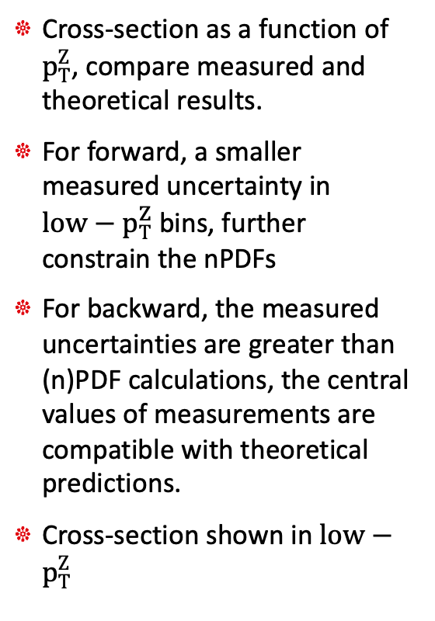
Cross-section result: $p_{T}^{Z}$
JHEP 06 (2023) 022
Cross-section as a function of $p_{T}^{Z}$, compare measured and theoretical results.
For forward, a smaller measured uncertainty in $low−p_{T}^{Z}$ bins, further constrain the nPDFs
For backward, the measured uncertainties are greater than (n)PDF calculations, the central values of measurements are compatible with theoretical predictions.
Cross-section shown in $low−p_{T}^{Z}$

Slide 8
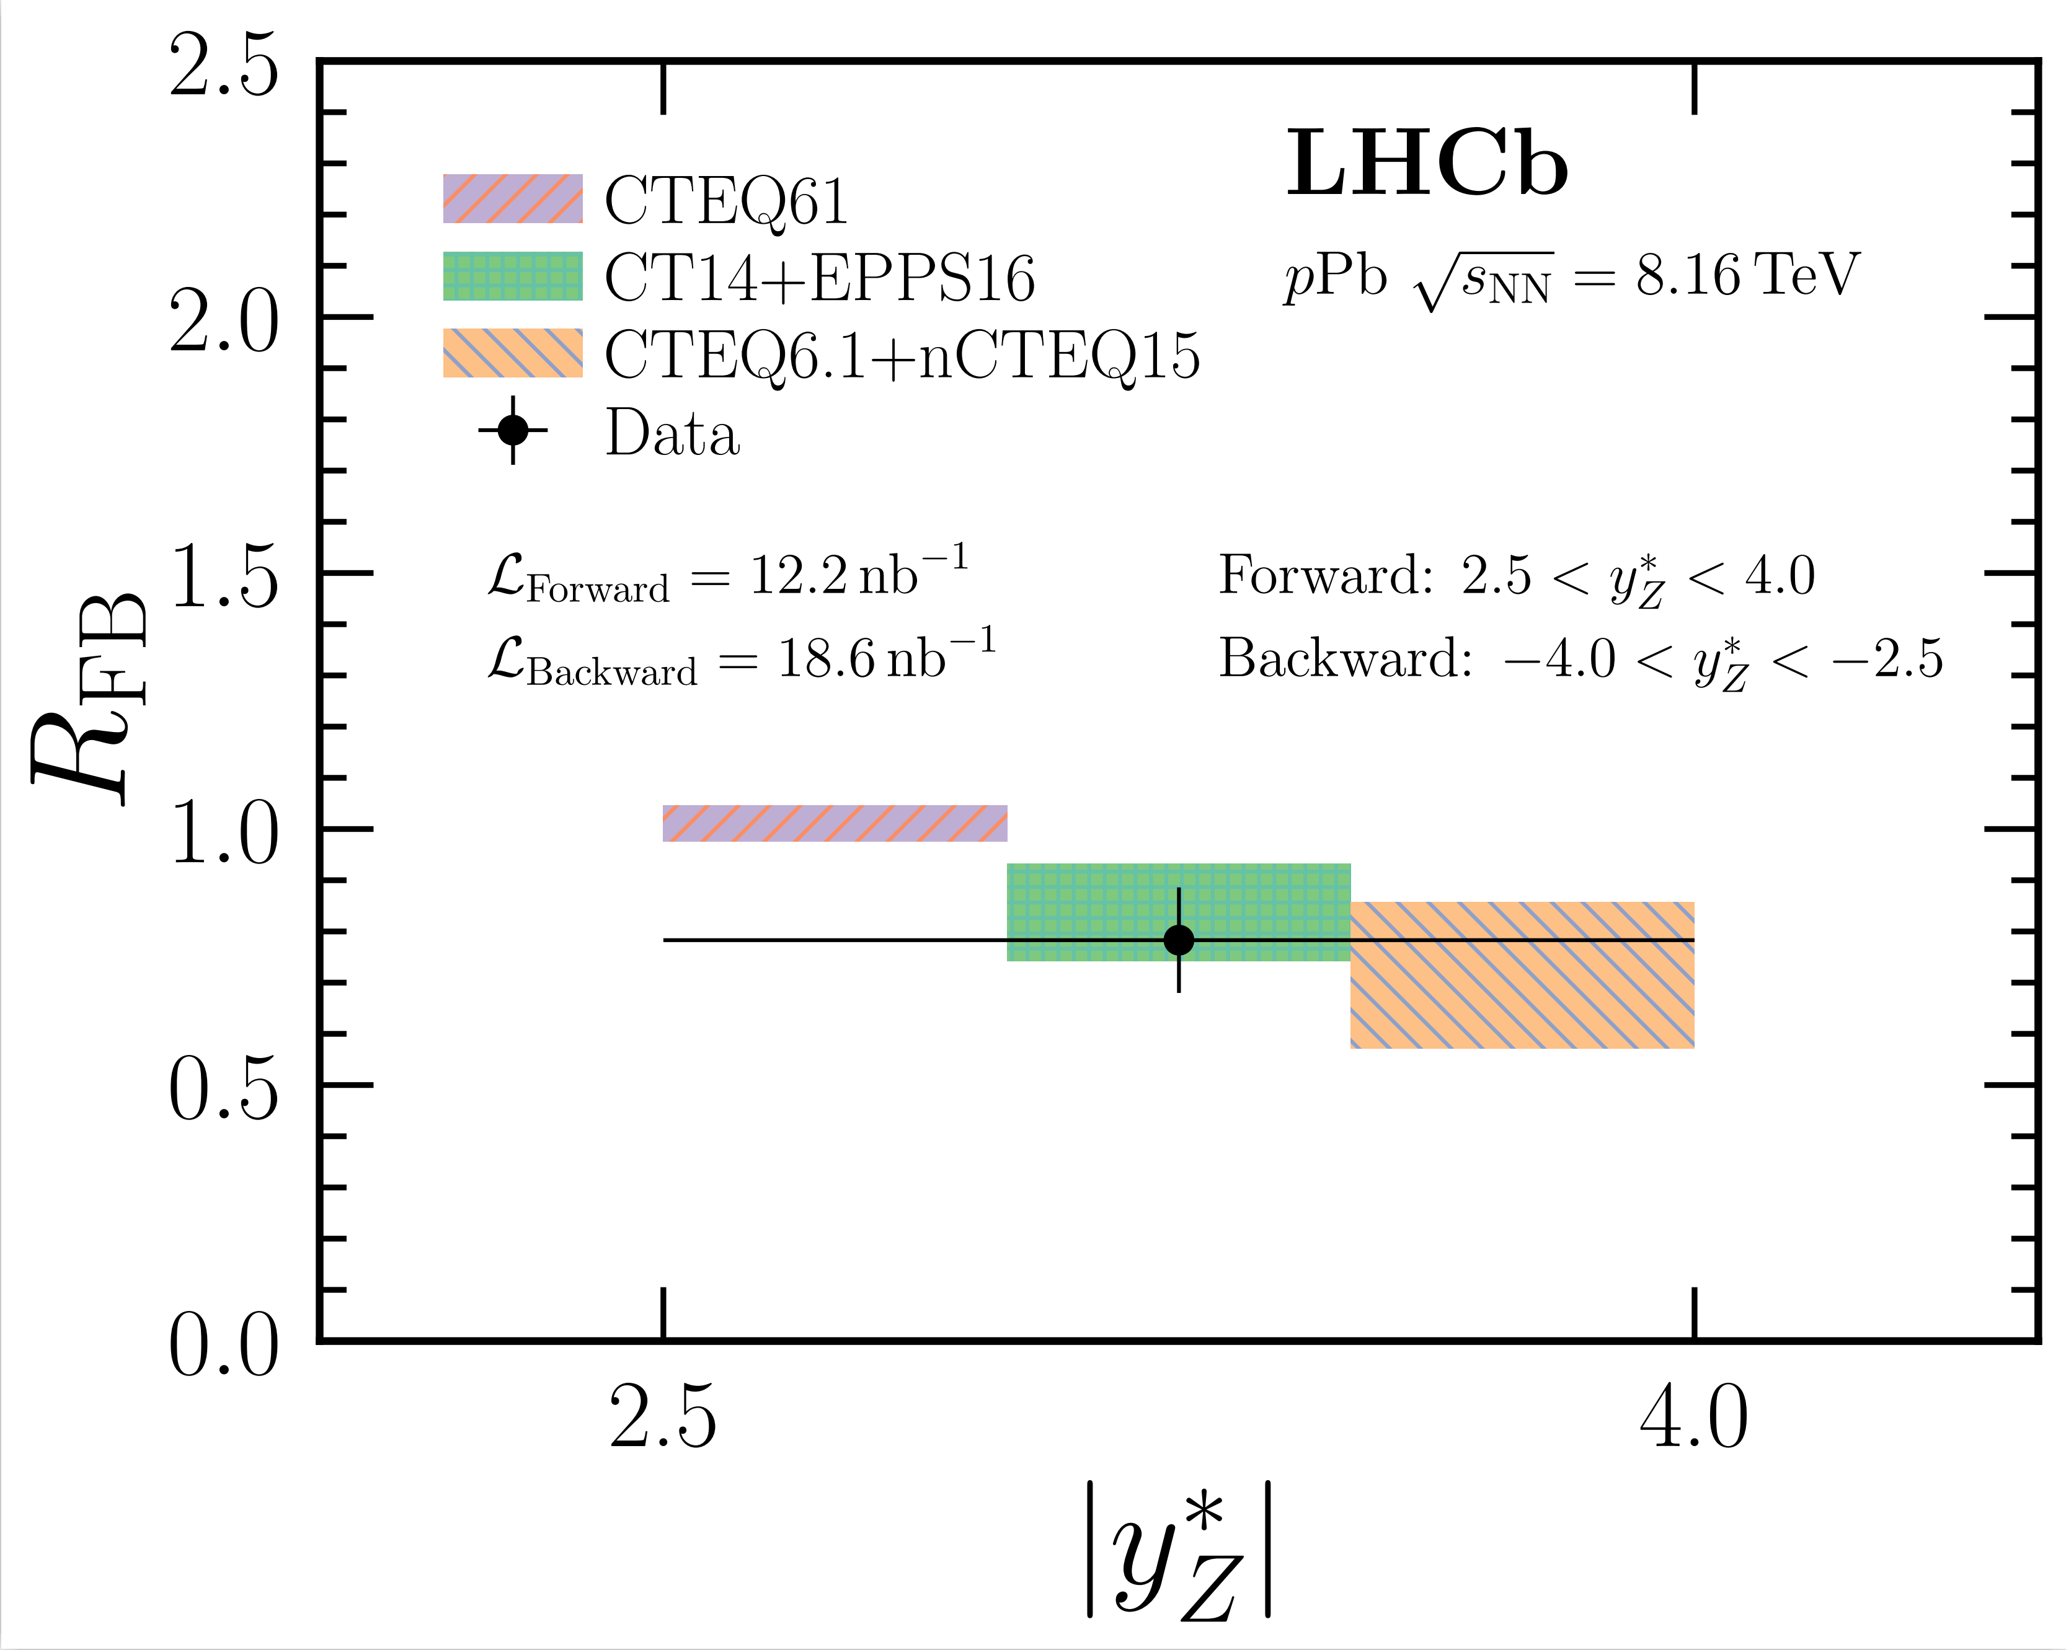
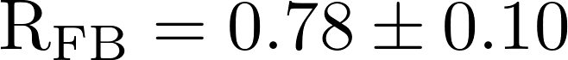

Forward-backward ratio $R_{FB}$
JHEP 06 (2023) 022
Forward and backward ratio is sensitive to nuclear effects in the Z production, probe the nuclear matter effects
Measured result:
The measurement shows a general suppression below one, is consistent with theoretical predictions, smaller uncertainty provide constraining power on the nPDFs.

Slide 9
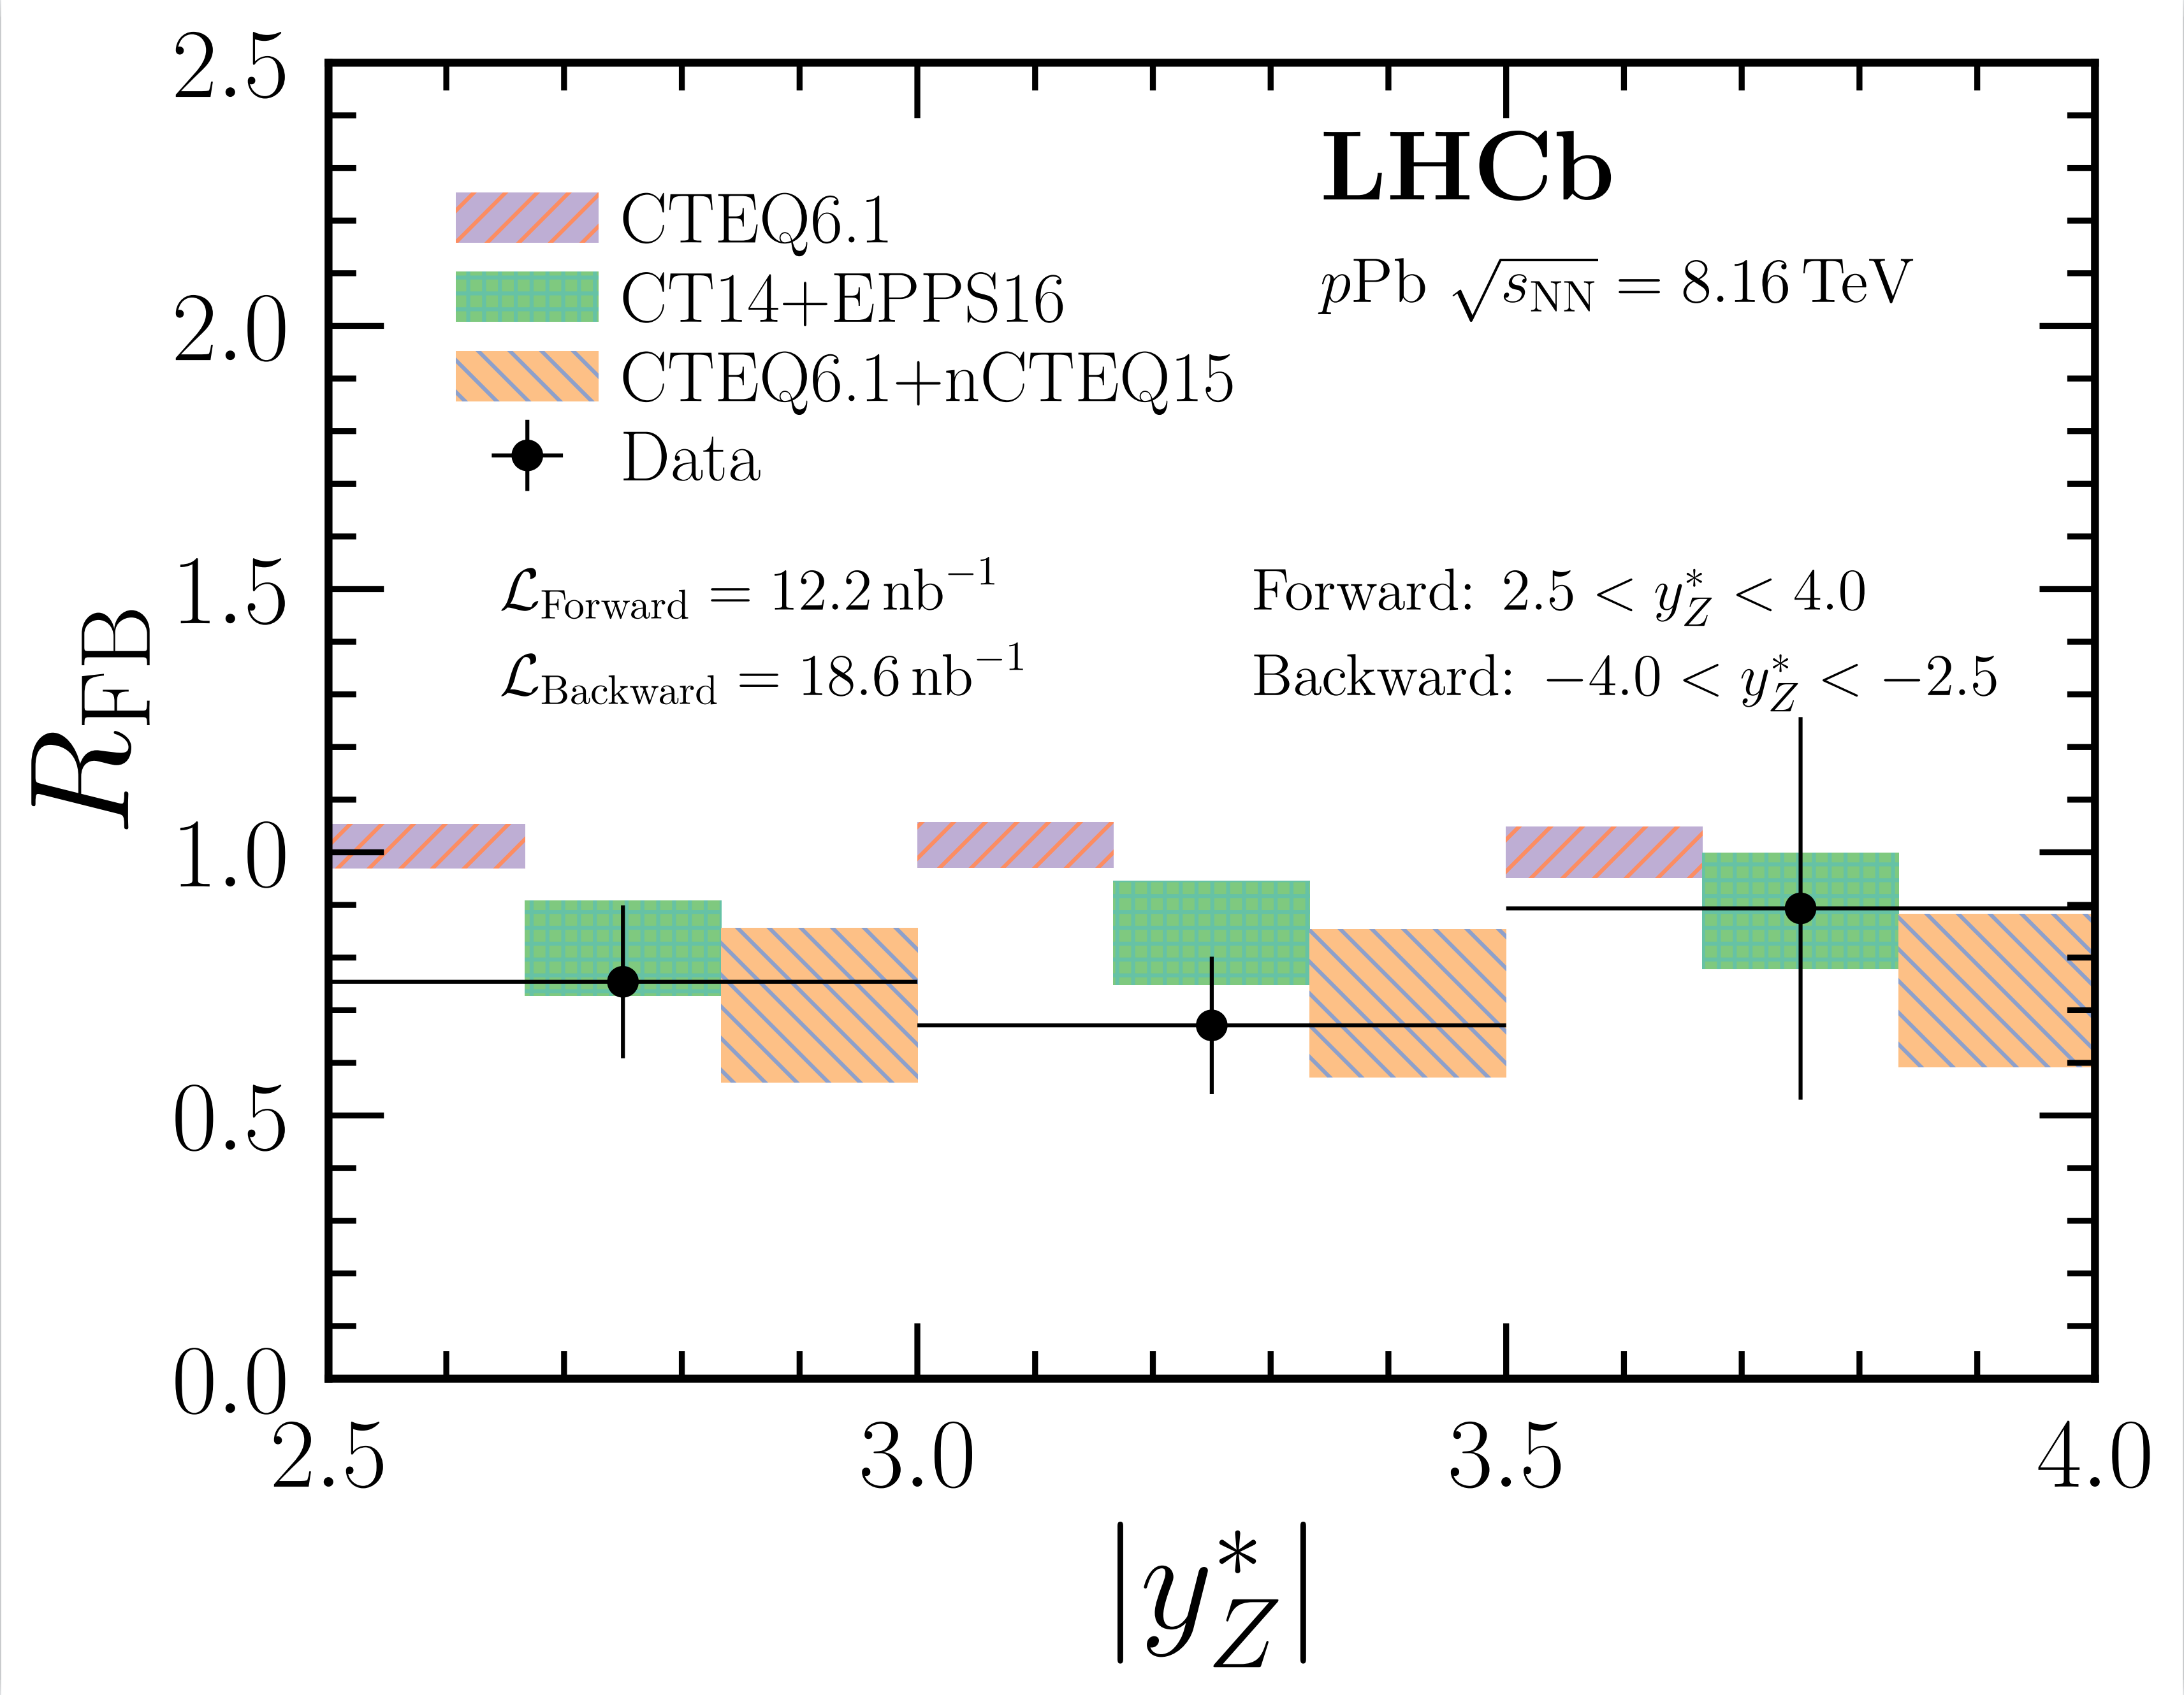
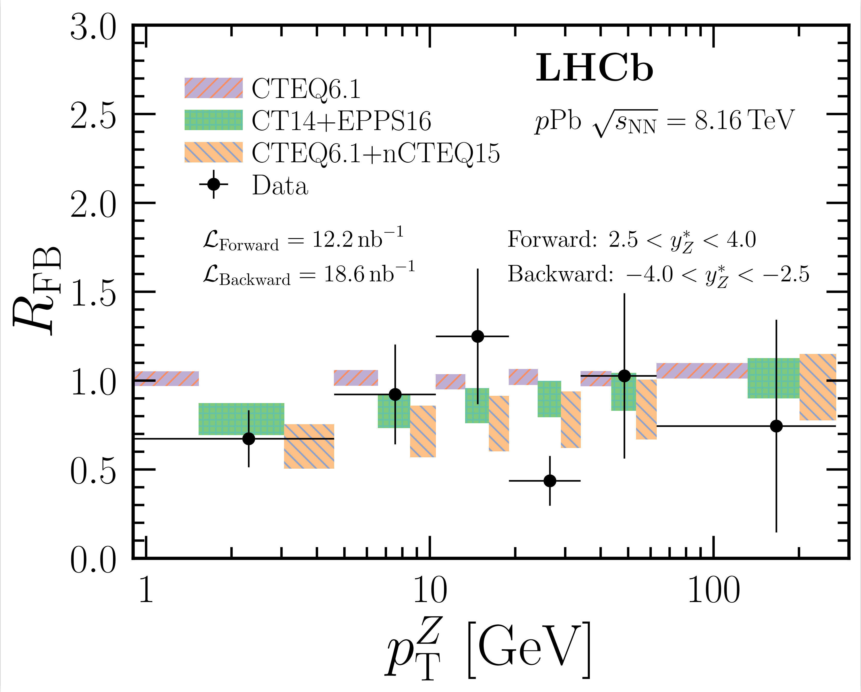
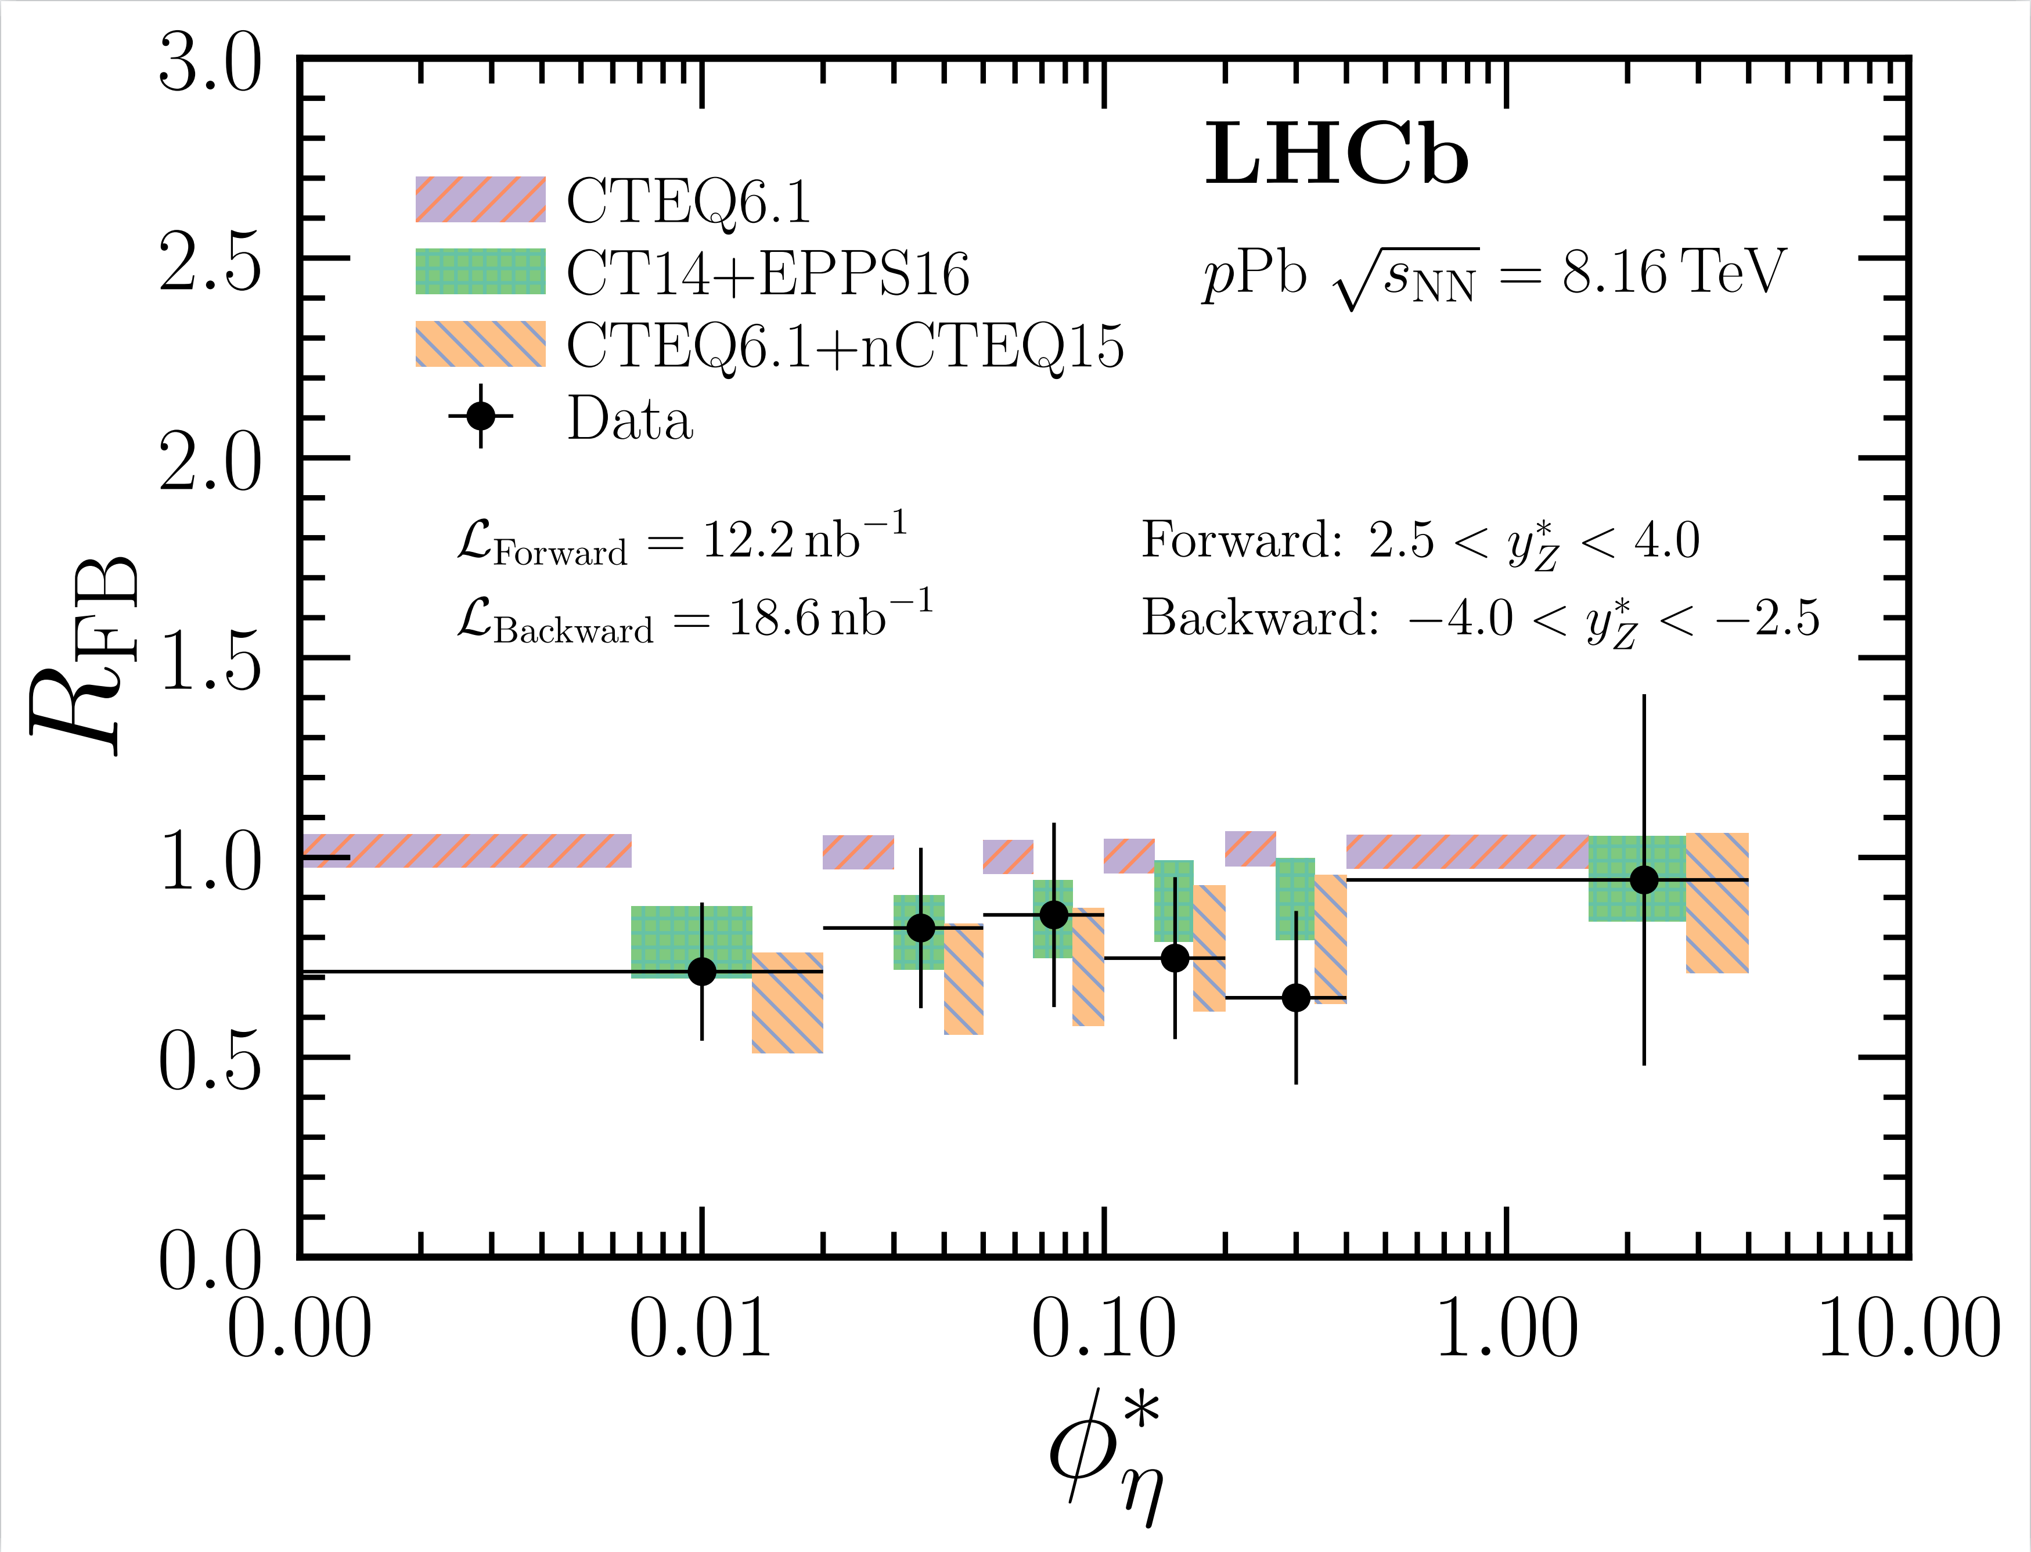
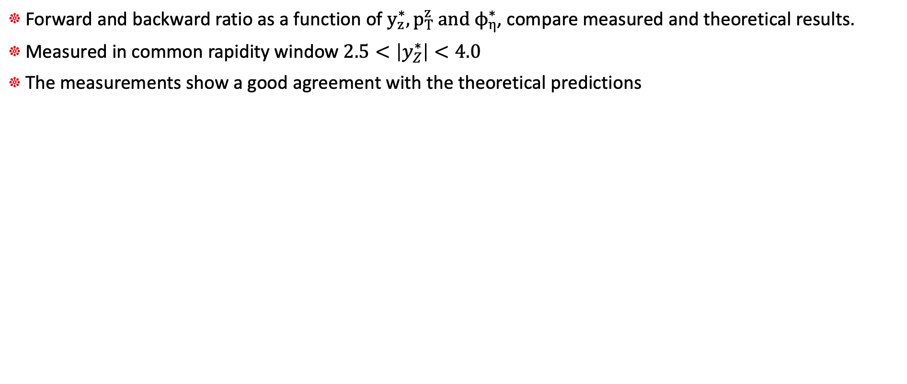
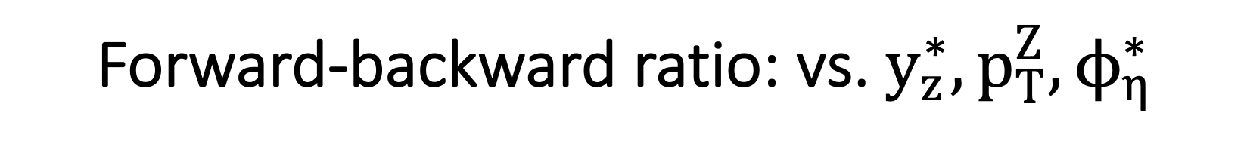
Forward-backward ratio: vs. $y_{z}^{∗}, p_{T}^{Z}, ϕ_{η}^{∗}$
JHEP 06 (2023) 022
Forward and backward ratio as a function of $y_{z}^{∗}, p_{T}^{z} and ϕ_{η}^{∗}$, compare measured and theoretical results.
Measured in common rapidity window $2.5<\left|y_{Z}^{∗}\right|<4.0$
The measurements show a good agreement with the theoretical predictions

Slide 10
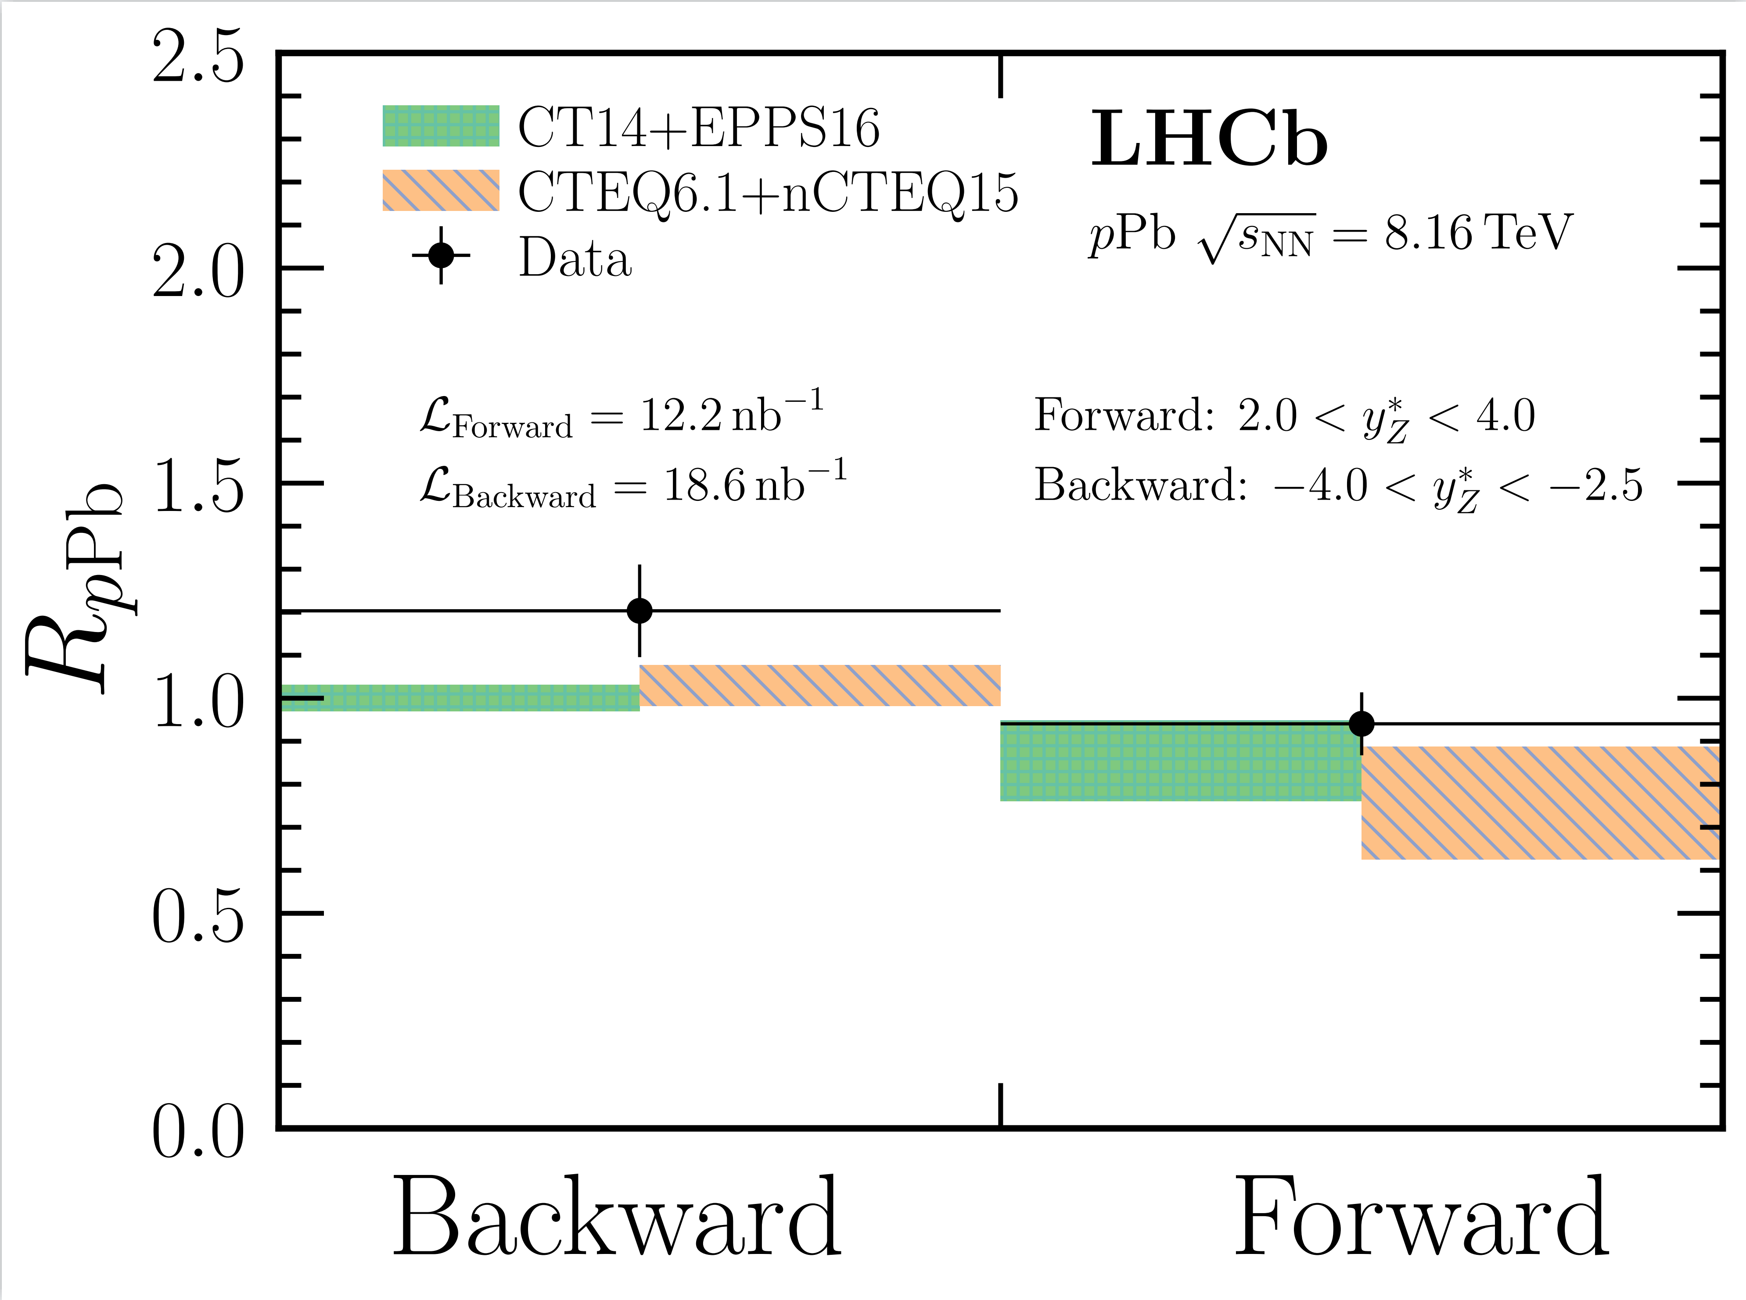
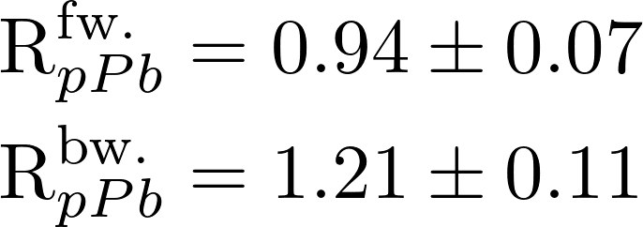
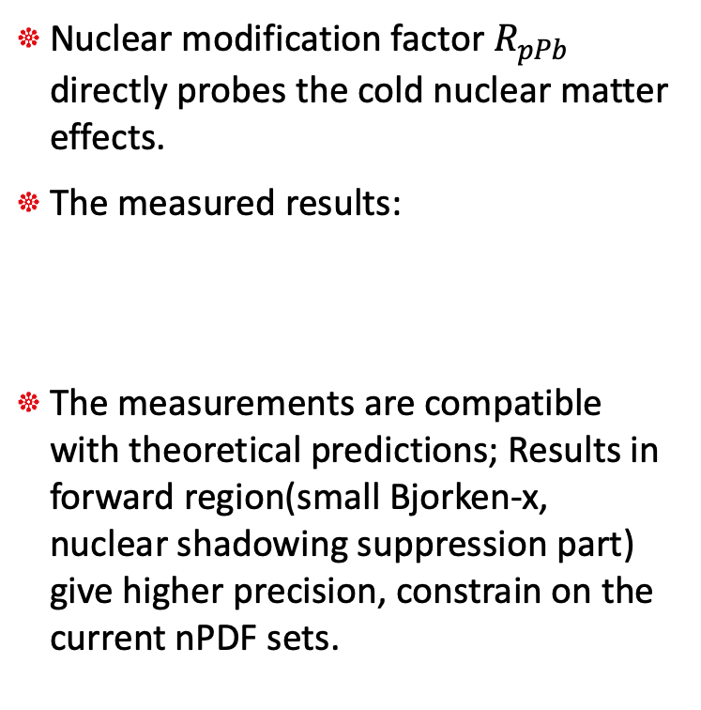

Nuclear modification $R_{pA}$: overall
JHEP 06 (2023) 022
Events for backward: 167
Events for forward: 268
Nuclear modification factor $R_{pPb}$ directly probes the cold nuclear matter effects.
The measured results:
The measurements are compatible with theoretical predictions; Results in forward region(small Bjorken-x, nuclear shadowing suppression part) give higher precision, constrain on the current nPDF sets.

Slide 11
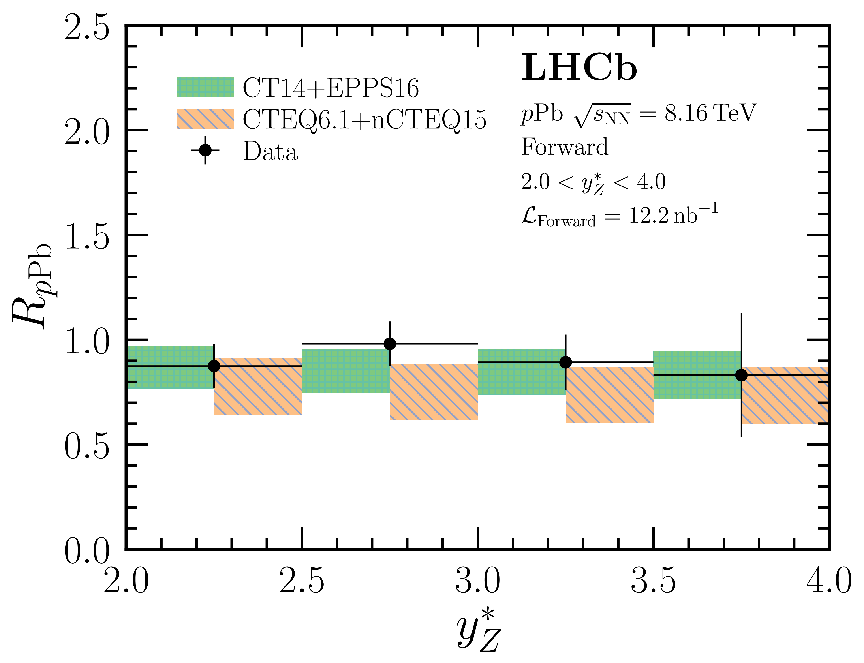
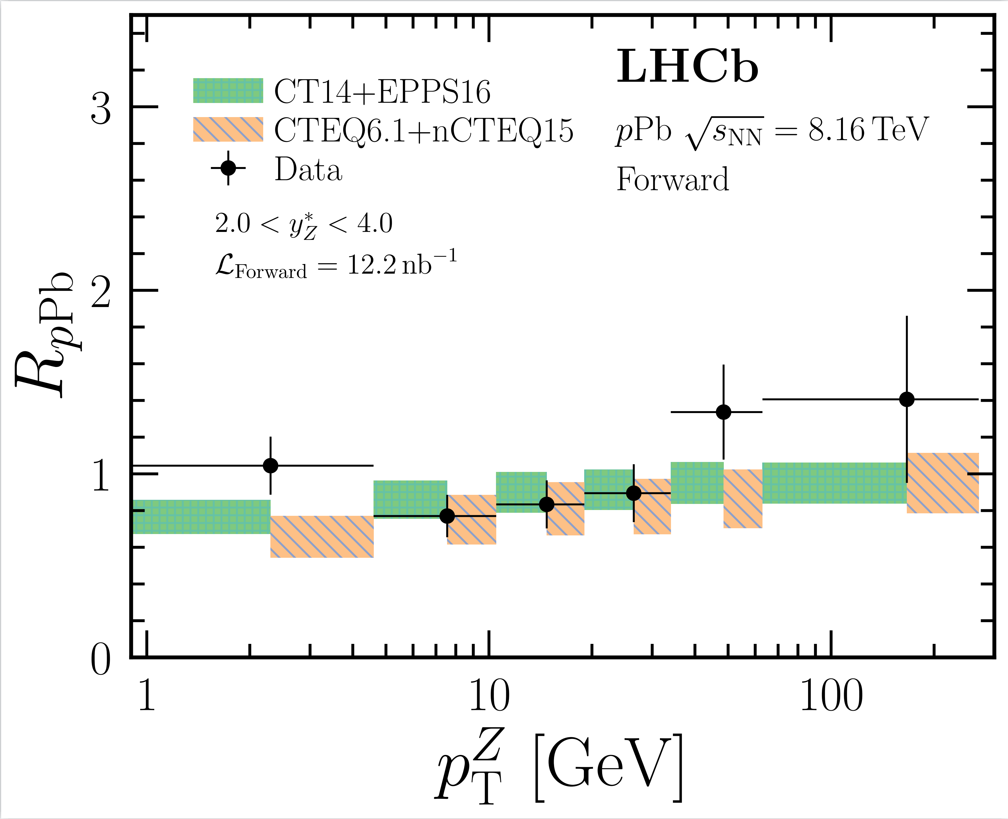
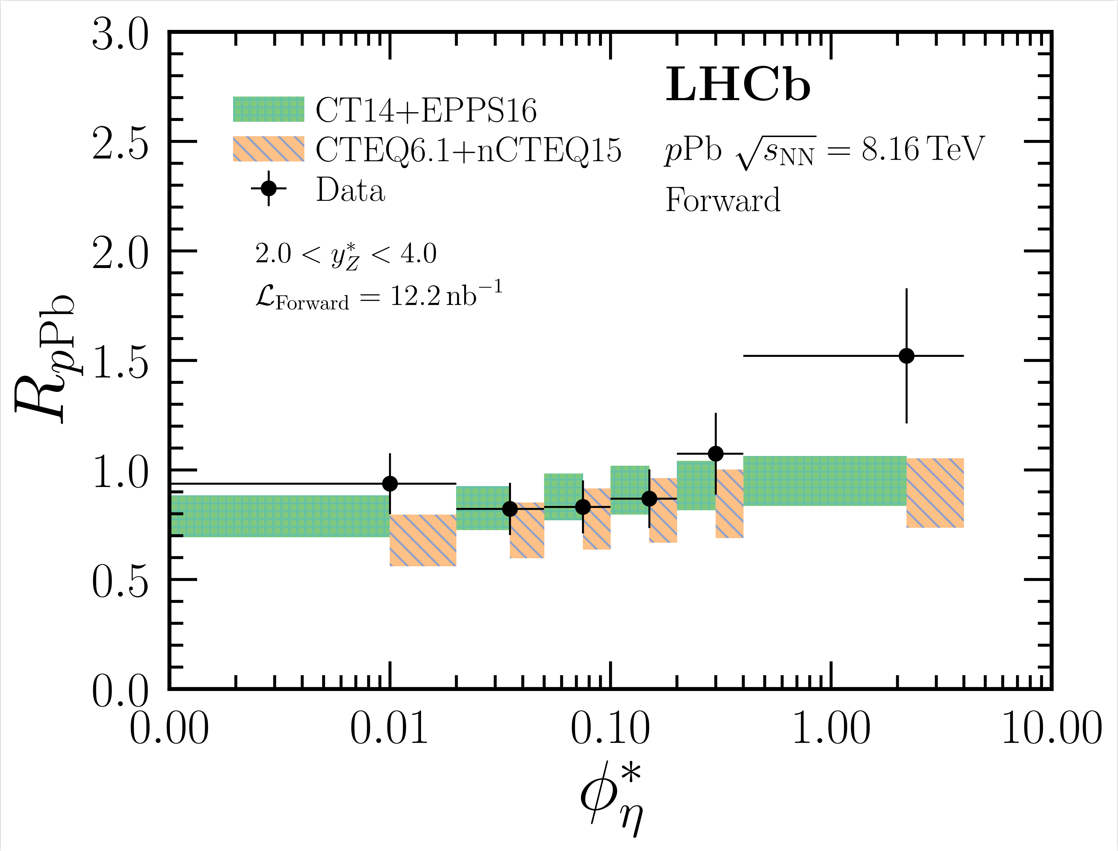
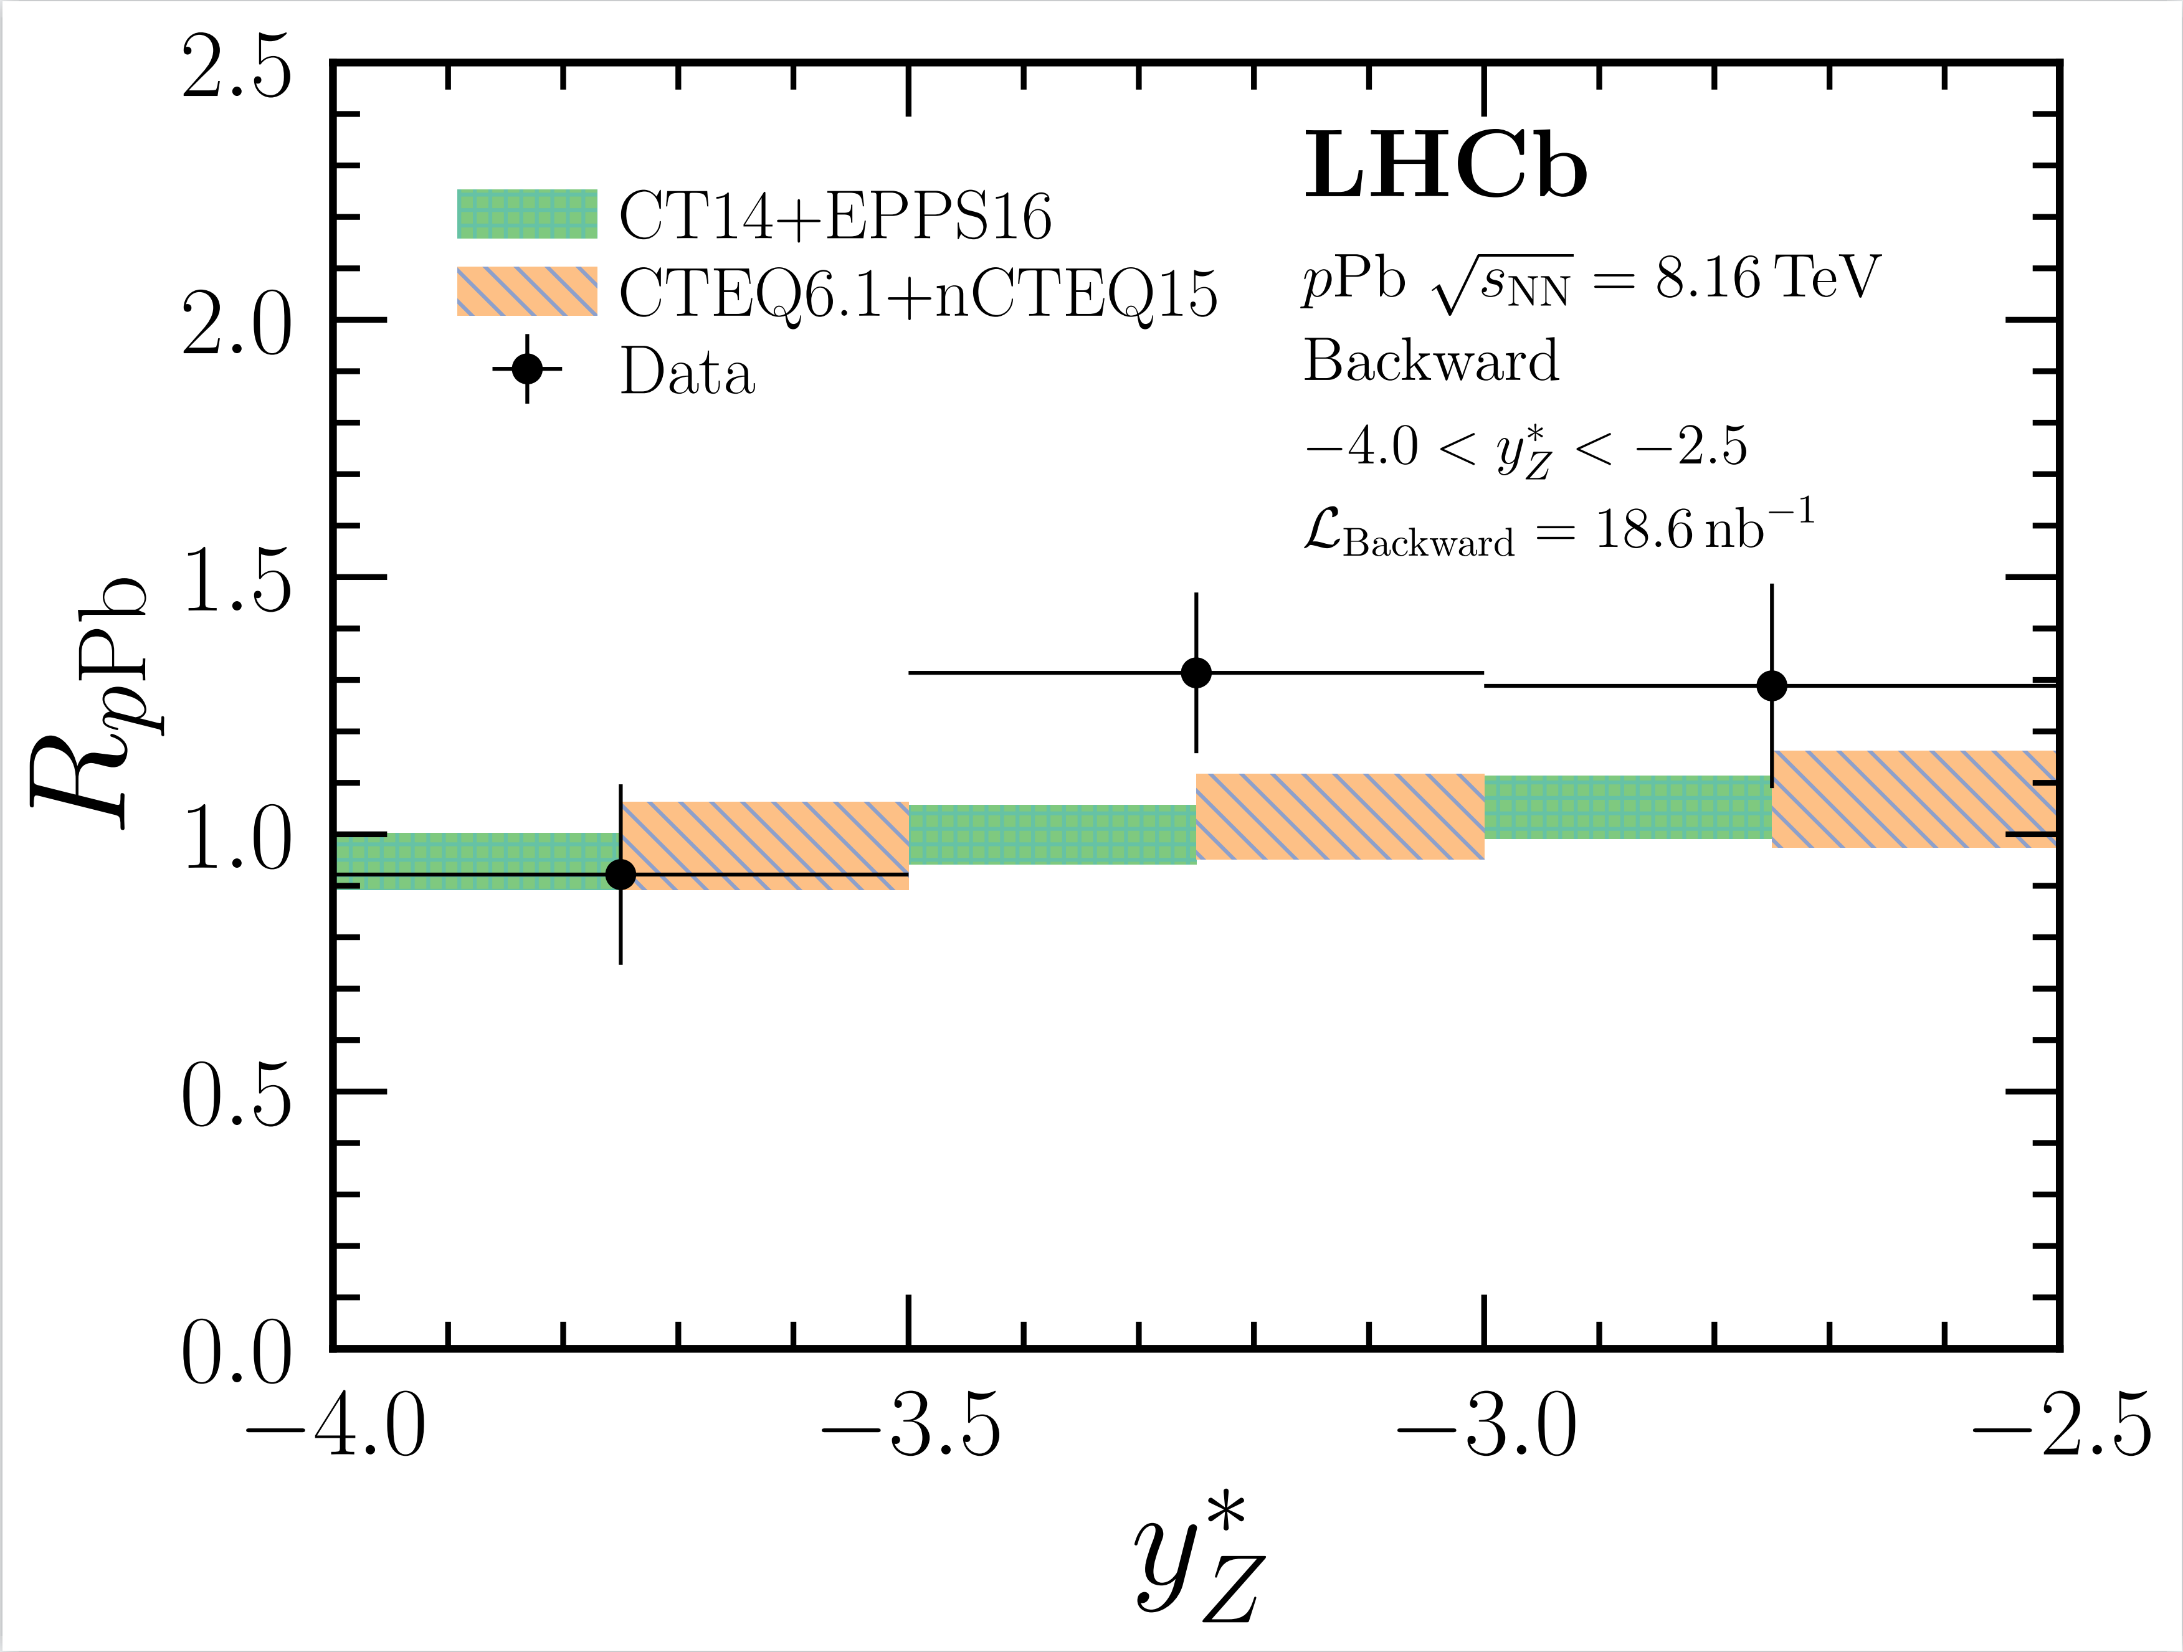
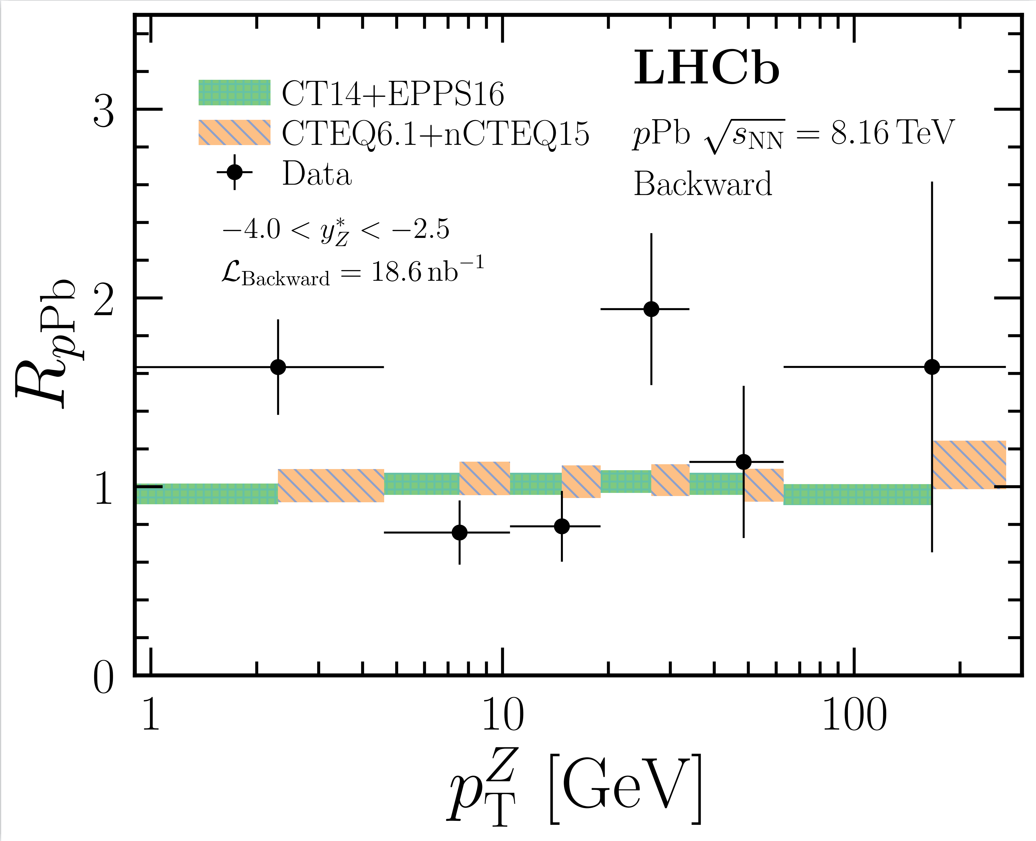
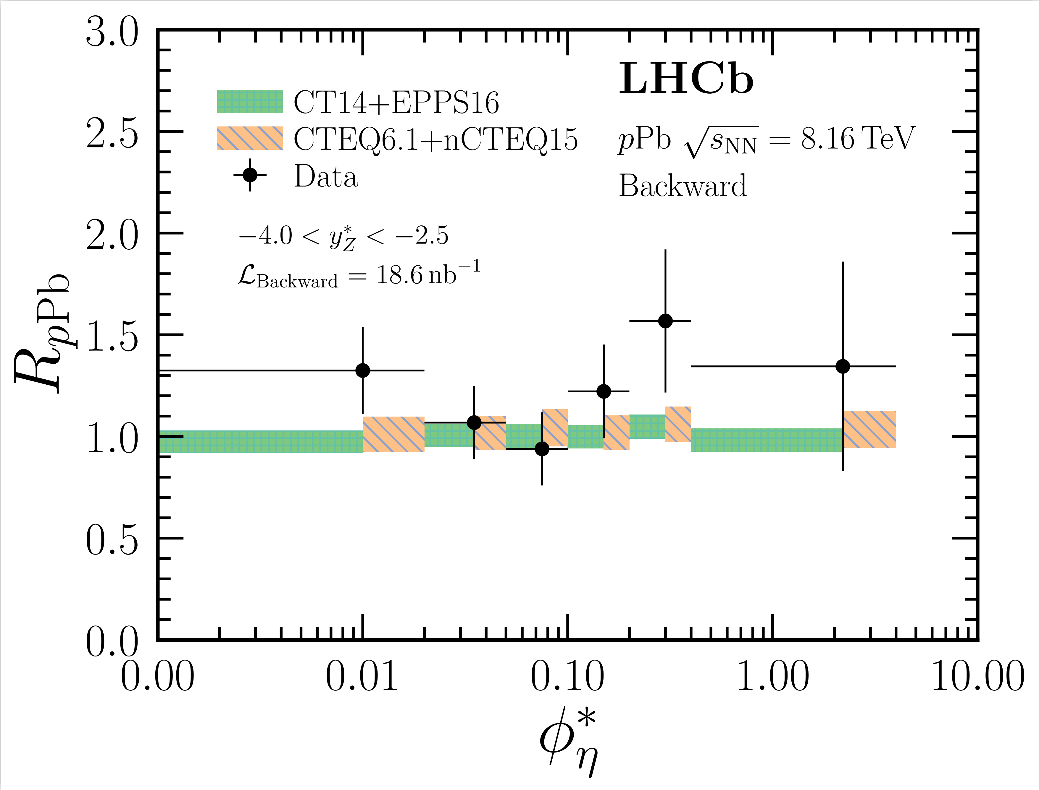
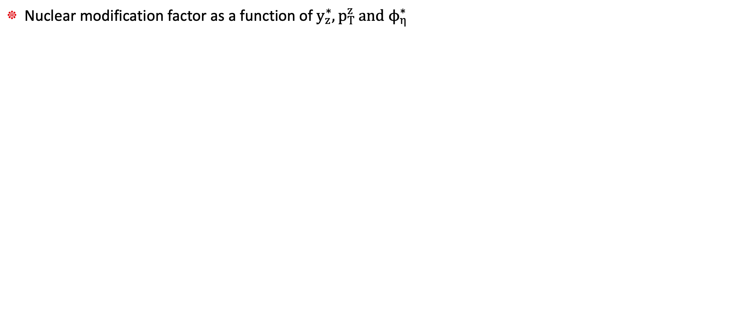
Nuclear modification factor
JHEP 06 (2023) 022
Nuclear modification factor as a function of $y_{z}^{∗}, p_{T}^{z} and ϕ_{η}^{∗}$

Slide 12
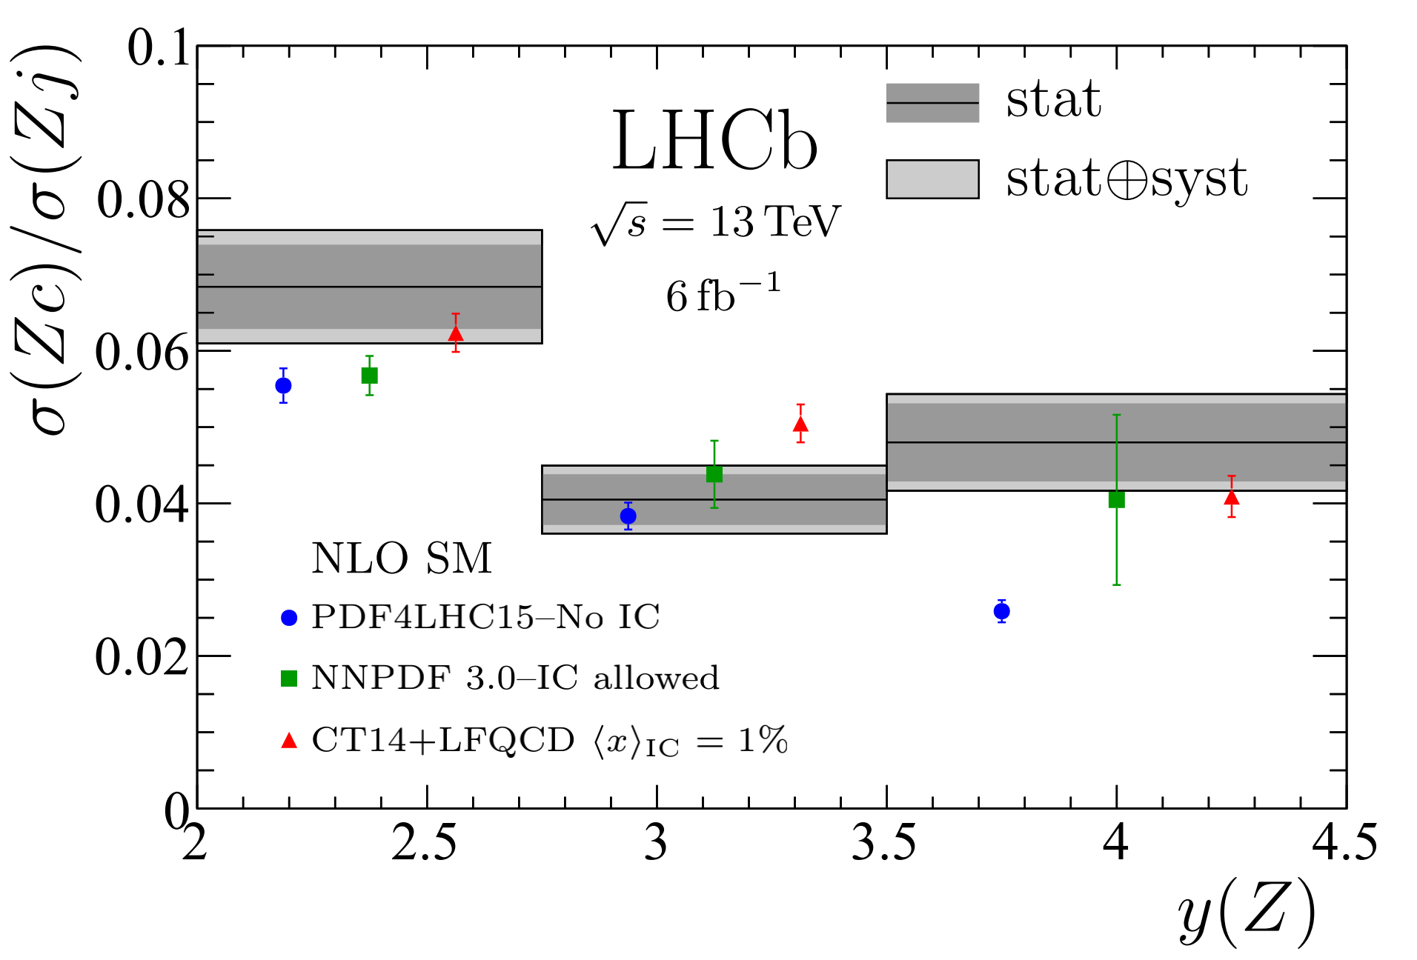
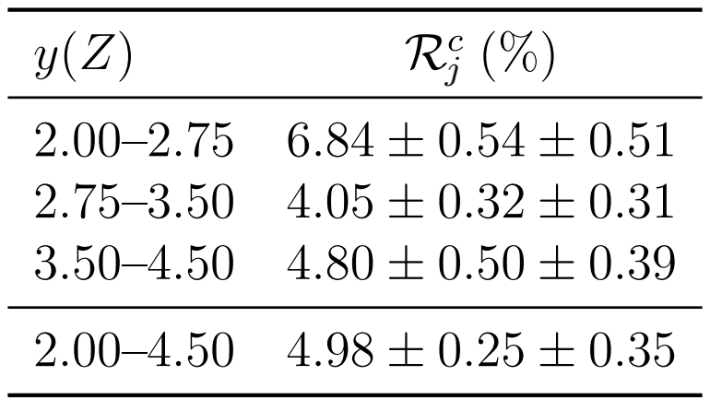
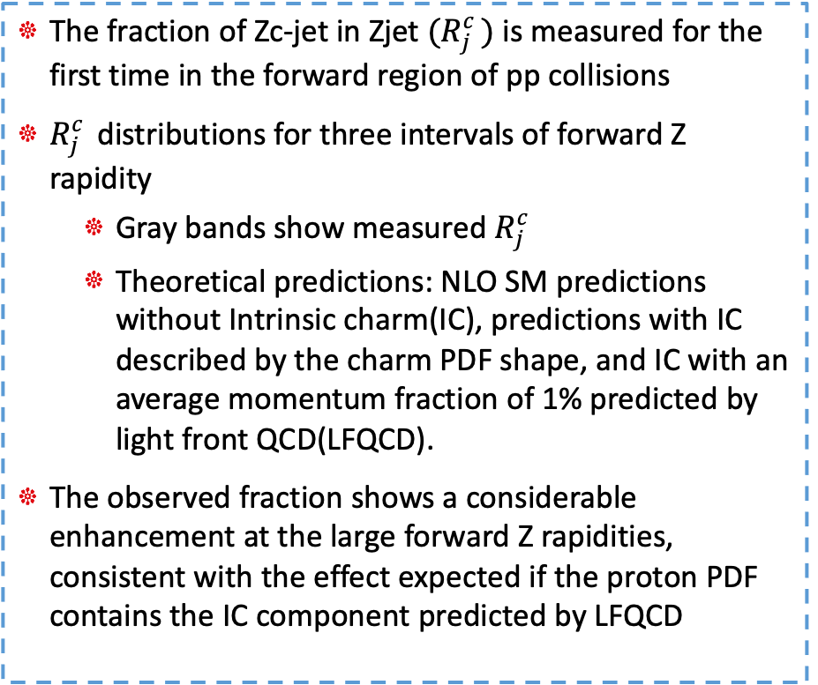

Zc production in pp collisions at 13TeV
PhysRevLett.128.082001
The fraction of Zc-jet in Zjet $(R_{j}^{c })$ is measured for the first time in the forward region of pp collisions
$R_{j}^{c }$distributions for three intervals of forward Z rapidity
Gray bands show measured $R_{j}^{c }$
Theoretical predictions: NLO SM predictions without Intrinsic charm(IC), predictions with IC described by the charm PDF shape, and IC with an average momentum fraction of 1% predicted by light front QCD(LFQCD).
The observed fraction shows a considerable enhancement at the large forward Z rapidities, consistent with the effect expected if the proton PDF contains the IC component predicted by LFQCD
Results for the $R_{j}^{c }$ measurements

Slide 13
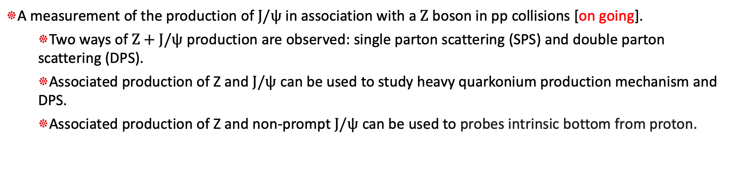
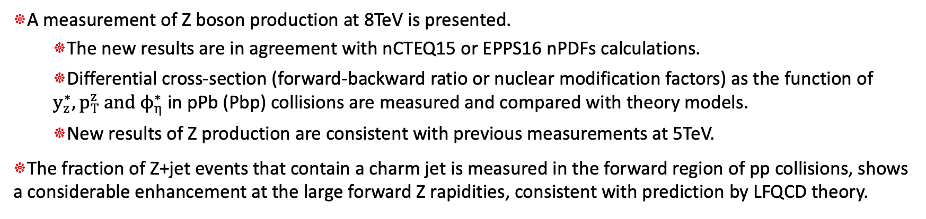
Summary
A measurement of Z boson production at 8TeV is presented.
The new results are in agreement with nCTEQ15 or EPPS16 nPDFs calculations.
Differential cross-section (forward-backward ratio or nuclear modification factors) as the function of $y_{z}^{∗}, p_{T}^{z} and ϕ_{η}^{∗}$ in pPb (Pbp) collisions are measured and compared with theory models.
New results of Z production are consistent with previous measurements at 5TeV.
The fraction of Z+jet events that contain a charm jet is measured in the forward region of pp collisions, shows a considerable enhancement at the large forward Z rapidities, consistent with prediction by LFQCD theory.
Outlook
A measurement of the production of $J/ψ$ in association with a $Z$ boson in pp collisions [on going].
Two ways of $Z+J/ψ$ production are observed: single parton scattering (SPS) and double parton scattering (DPS).
Associated production of Z and $J/ψ$ can be used to study heavy quarkonium production mechanism and DPS.
Associated production of Z and non-prompt $J/ψ$ can be used to probes intrinsic bottom from proton.
Thanks for your attention!

Slide 14
Back up

Slide 15


Zjpsi production in pp collisions at 13TeV
$Z+J/ψ$ in pp collisions probes the production mechanisms of quarkonium in association with vector bosons, allows studies of multiple partonic Interactions (MPI).
Two production mechanisms: single parton scattering (SPS) and double parton scattering (DPS).
DPS: two hard parton-parton interactions in a single proton-proton collision.
the simplest MPI process, depends on speciﬁc non-perturbative quantities: the double parton distribution functions (dPDFs).
related to multi-parton correlation and to the spatial structure of hadrons.

Slide 16





Zc production in pp collisions at 13TeV
PhysRevLett.128.082001
Zc production at electroweak scale, hadronic effects are small
Use the ratio of cross section between Zc and Zj (events of a Z boson and any type jet) to manifest:
cancel some experimental and theoretical uncertanties
The leading-order Zc production mechanism is
Use NLO standard model calculate the ratio as a function of Z rapidity
Intrinsic charm (IC) contribution enhance c-jet production at large Z rapidity

Slide 17


Zc production in pp collisions at 13TeV
PhysRevLett.128.082001
Data sample: integrated luminosity of $6fb^{−1}$, pp collisions at a center-of-mass energy of 13 TeV
Z bosons: reconstructed using the $Z→μ^{+}μ^{−}$ decay
The c-jet as a jet containing a c-hadron, identified by tagging secondary vertices
Measurement strategy:
N(c-tag) is observed Zc yield
c-tag efficiency, calculated by using dijet data
N(j) is total Zj yield, reconstructed in the fiducial region
Determining Zc yields using displaced-vertex(DV) based tagging method
Find a displaced-vertex signature from a jet cone
Two properties of DV are used: number of tracks in DV ($N_{trk}$) and corrected mass
θ, angle between the momentum and the flight direction of the DV
jet
Secondary vertex(displaced-vertex)
PV

Slide 18


Zc production in pp collisions at 13TeV
PhysRevLett.128.082001
Z bosons: reconstructed using the $Z→μ^{+}μ^{−}$ decay
Jet reconstruction is performed offline by clustering charged and neutral particle-flow candidates using the anti-kT clustering algorithm as implemented in FastJet
$ΔR :$ used to separate muons and jet, defined as
to ensure that the muons and jets are well separated

Slide 19



Zc production in pp collisions at 13TeV
PhysRevLett.128.082001
The $m_{cor}(DV)$ and $N_{trk}(DV)$ distributions for DV-tagged candidates of the Zj data sample
Calculate the reconstructed Zc yields from fit resuts of Zj data

Slide 20





Z prodution in pPb collisions at 8TeV
Cross-section:
$N_{cand}$ is the number of selected Z candidates
$ℒ$ is the integrated luminosity
$ρ$ is the purity (the fraction of actual signal events)
$f_{FSR}$ is final state radiation correction, defined as the ratio of the generator level MC yields (after fiducial selection) between without/with FSR turned on, calculated by POWHEG+PYTHIA8
$ϵ_{tot}$ is the total signal efficiency

Slide 21

Z prodution in pPb collisions at 8TeV
Rapidity shift

Slide 22


Z prodution in pPb collisions at 8TeV
P-value as a function of $p_{T}^{z}$
Significance and p-value results of xsec
significance | 1.3286092 | -0.98333581 | -0.15782034 | 3.45010288 | 0.99996401 | 0.25099433
p-value | 9.19885e-02 | 8.37279e-01 | 5.62701e-01 | 2.80186e-04 | 1.58664e-01 | 4.00910e-01

Slide 23


Z prodution in pPb collisions at 8TeV
Data yields in bins of $p_{T}^{z}$
Debugging one bin excess: https://indico.cern.ch/event/1001006/#3-debugging-the-bump-in-ptz-sp

Slide 24


Z prodution in pPb collisions at 5 TeV
JHEP09(2014)030
Fiducial cross-section results:
Compatible with theoretical calculations using FEWZ:
MSTW08 for both p and Pb
MSTW08 for p and EPS09 for Pb

Slide 25




Z prodution in pp collisions at 13TeV
ARXIV:2112.07458
Data sample: $Z→μ^{+}μ^{−}$, at 13 TeV in pp collision
Integrated luminosity: 5.1 $fb^{−1}$
Comparison of the integrated cross-section between data and theoretical predictions.
The fiducial cross-section is measured as

